Slide 1
Dave - PureEdgeSim
Drone Simulation

Slide 2
Table of Content
Overview  Slide 3
Map  Slide 4
Results
Single Drone Scenario
0% Offloading Rate  Slide 5
3% Offloading Rate  Slide 6
5% Offloading Rate  Slide 7
9% Offloading Rate  Slide 8
12% Offloading Rate  Slide 9
18% Offloading Rate  Slide 10
20% Offloading Rate  Slide 11
27% Offloading Rate  Slide 12
34% Offloading Rate  Slide 13
45% Offloading Rate  Slide 14
100% Offloading Rate  Slide 15
Summary  Slide 16
Multi Drone Scenario
Simulation map for multi drone scenarios  Slide 17
CPU Utilization & Success rate per scenario Slide 18
Offloaded tasks success rate for different acceptable latency Slide 19

Slide 3
Simulation Overview
The present simulation models a drone moving at a speed of 10 km/h. It navigates through a graph structure representing the network infrastructure of an area with a 2-kilometer diameter from the center Berlin.
GNBs (gNodeBs) have been placed at specific locations determined by geoinformation data for the particular area.
A frame processing algorithm is executed 15 times per second, with an average drone inference time of 53.7 ms and a standard deviation of 3 ms.
Based on a defined offloading rate, scenarios are examined where the drone offloads a percentage of the generated tasks to the nearest Edge Datacenter.
The offloaded image size has an average of 118 KB and a standard deviation of 63 KB, while the inference time at the Edge Datacenter averages 23.7 ms with a standard deviation of 0.33 ms.
Simulation Duration : 80 to 10 min
Drone Speed : 10km/h
Failure limits for tasks: Total time > 100ms
Offloading image size: Average: 118KB, std: 63KB
Scenario Name | Offloading Rate (%)
50% | 0%
55% | 3%
60% | 5%
65% | 9%
70% | 12%
75% | 18%
80% | 20%
85% | 27%
90% | 34%
95% | 45%
100% | 100%

Slide 4
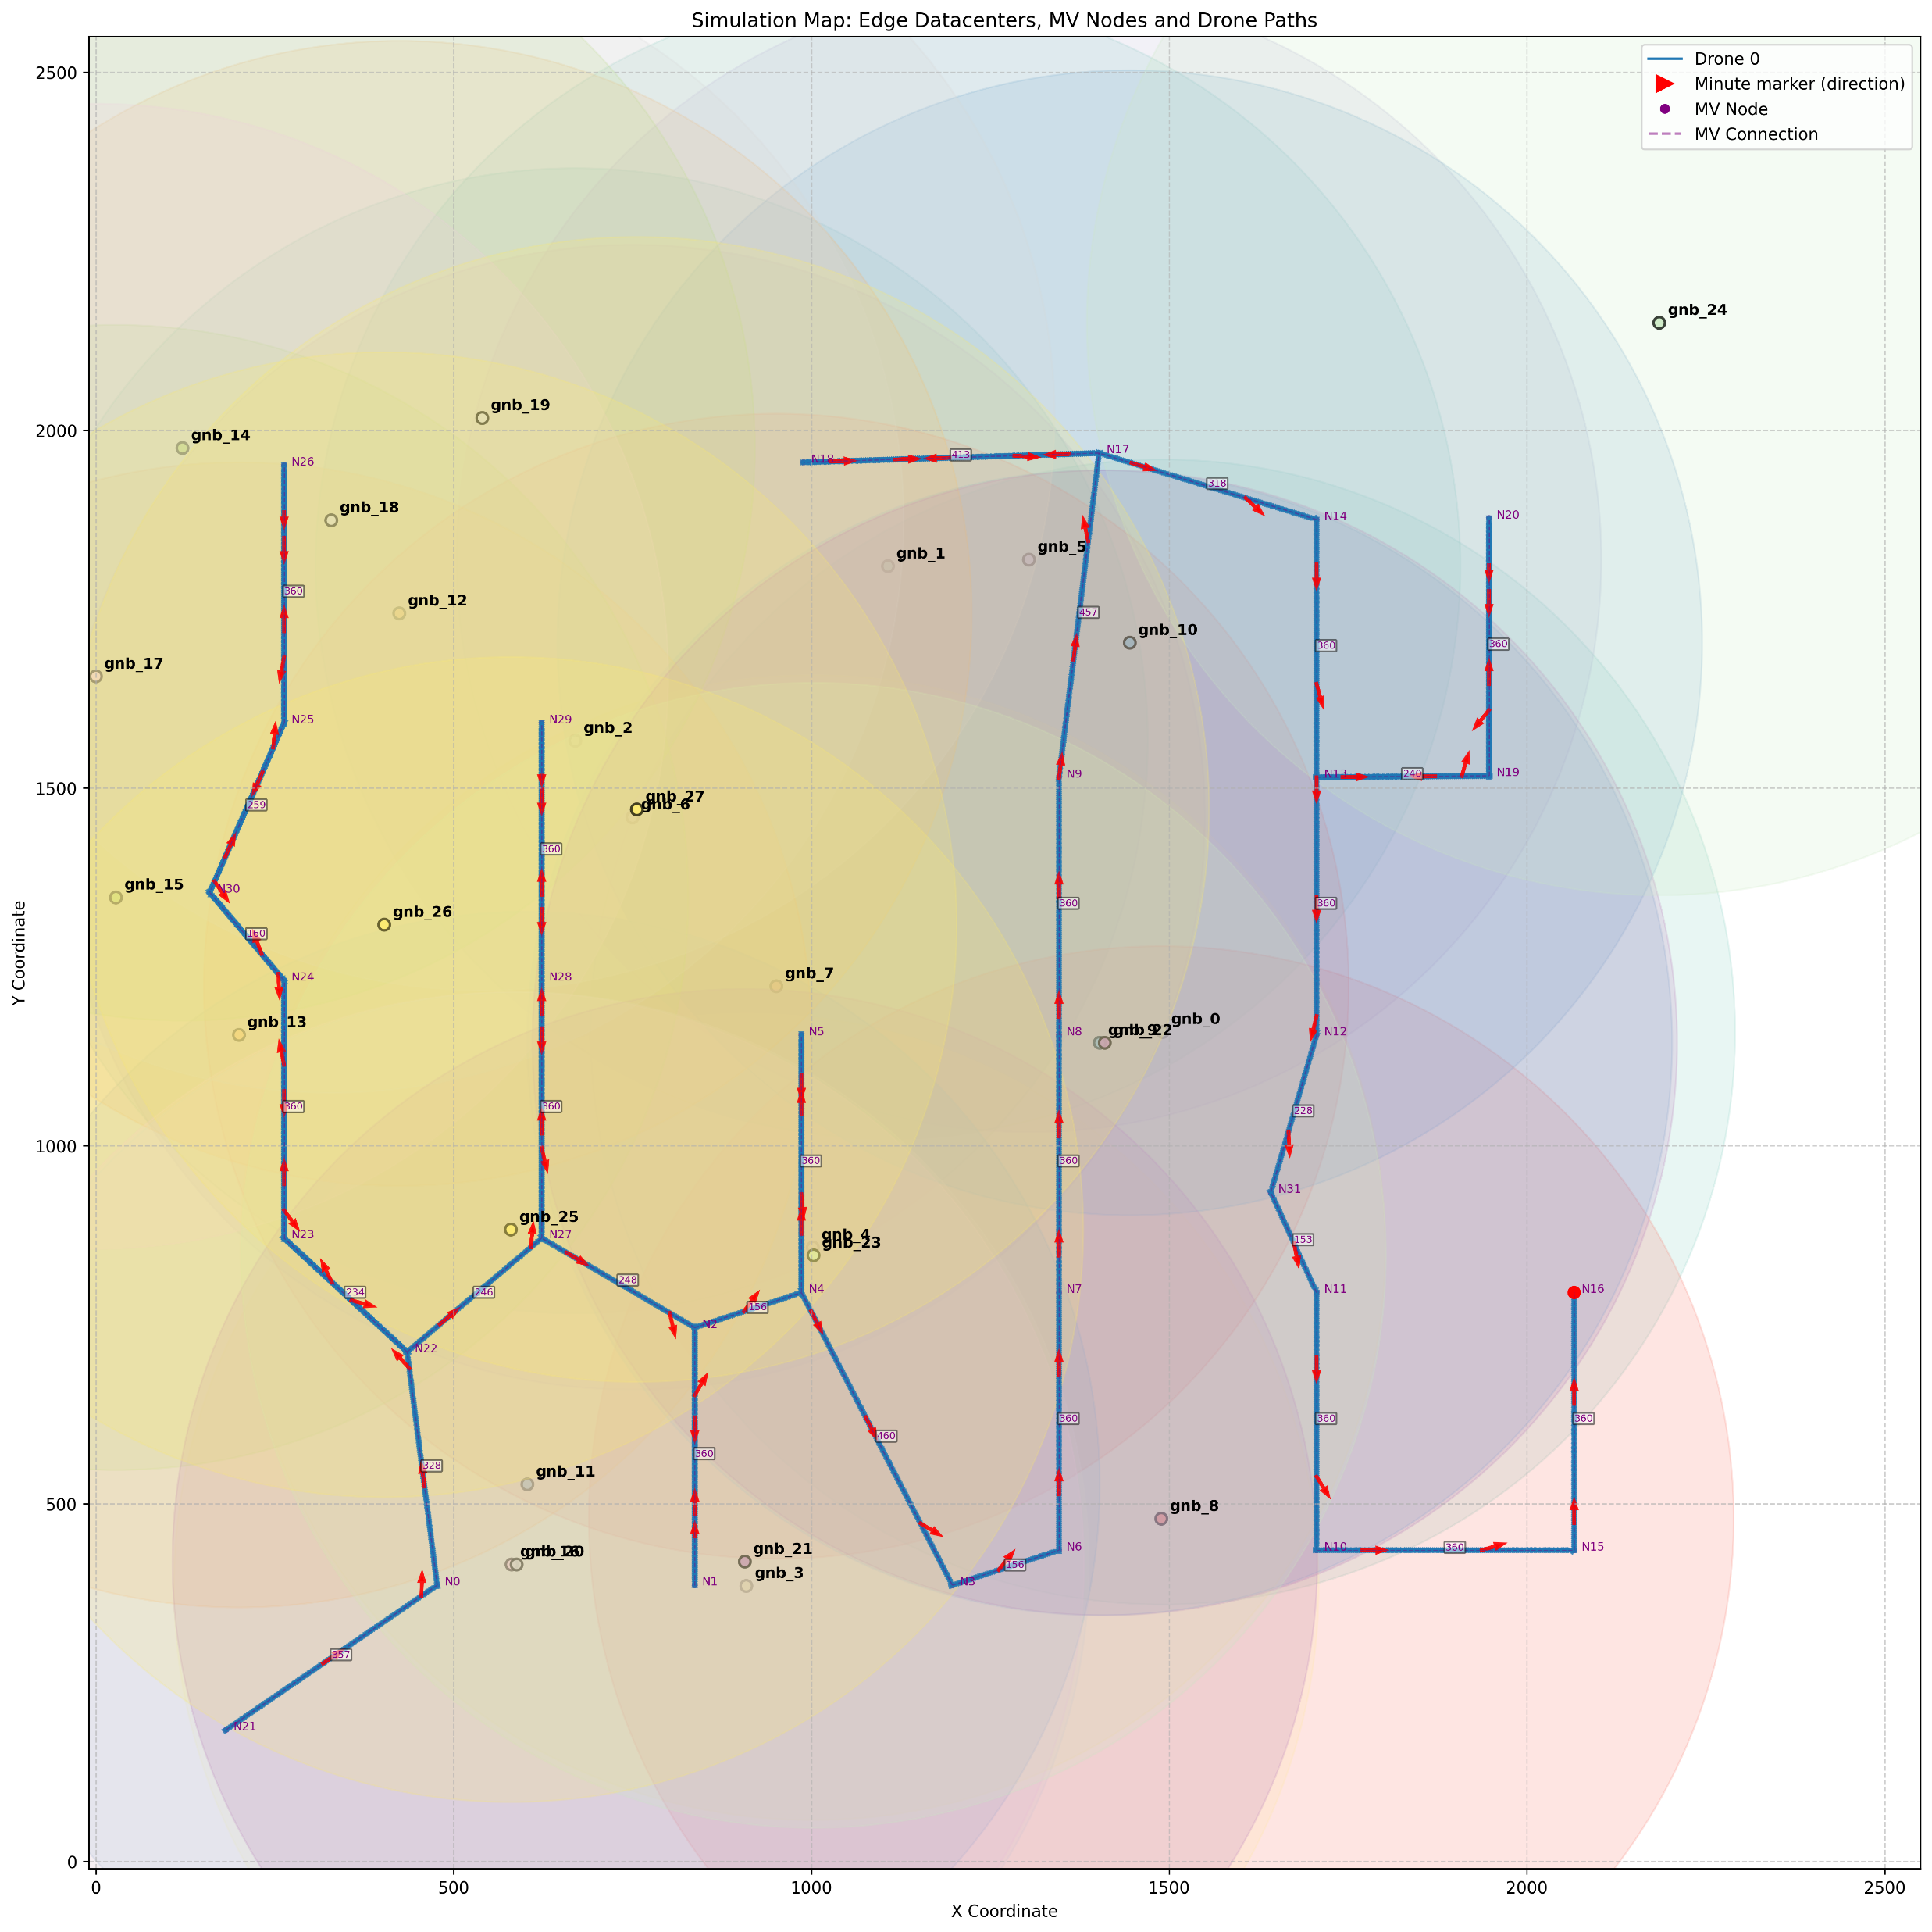
Simulation Map
Drone sends data to the closest Edge server throw cellular layer (5G)
cellular_bandwidth = 800
cellular_device_transmission_nanojoules_per_bit = 10
cellular_device_reception_nanojoules_per_bit = 10
cellular_base_station_nanojoules_per_bit_up_link = 20
cellular_base_station_nanojoules_per_bit_down_link = 100
cellular_latency = 0.01

Slide 5
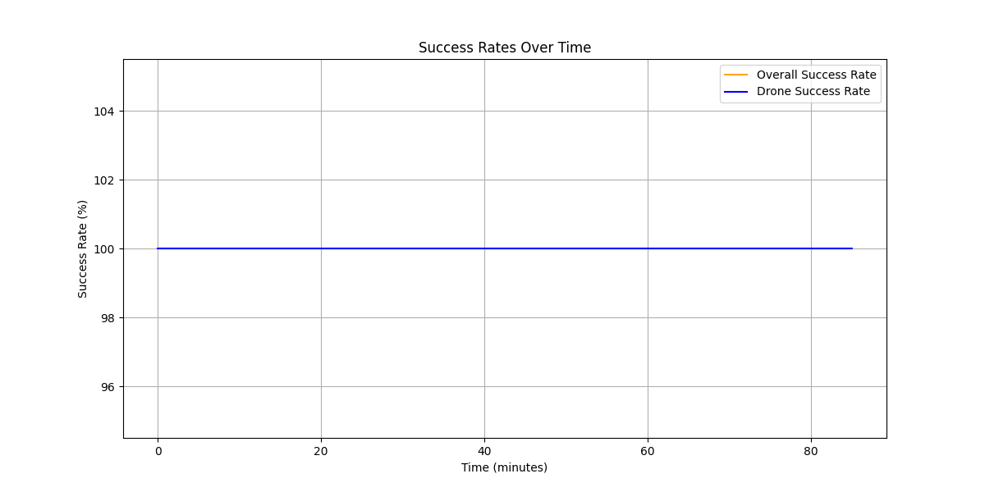
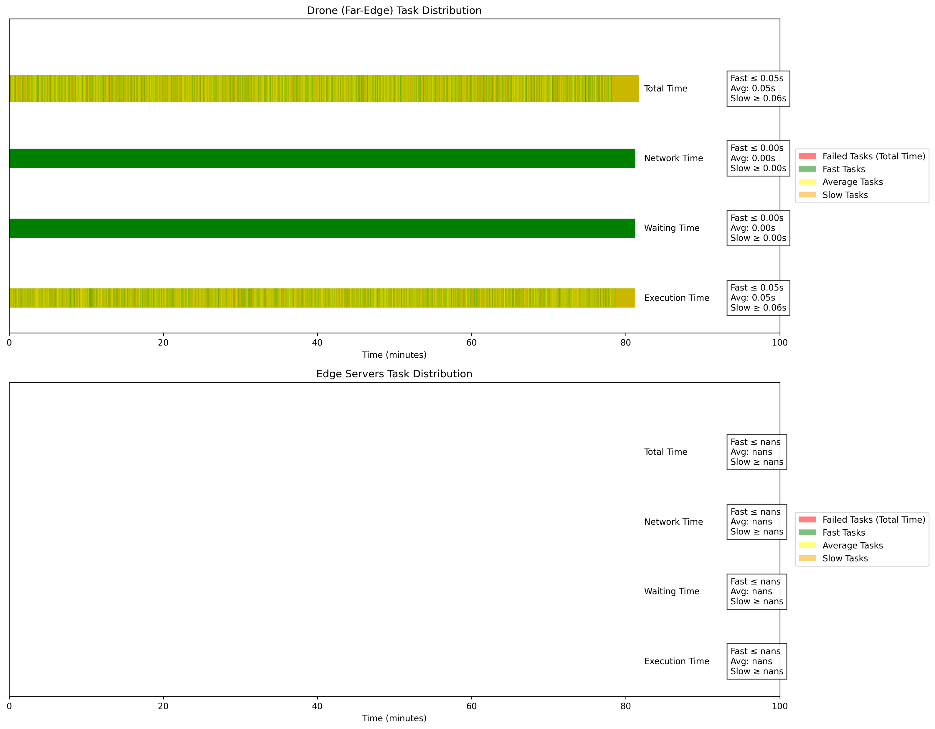
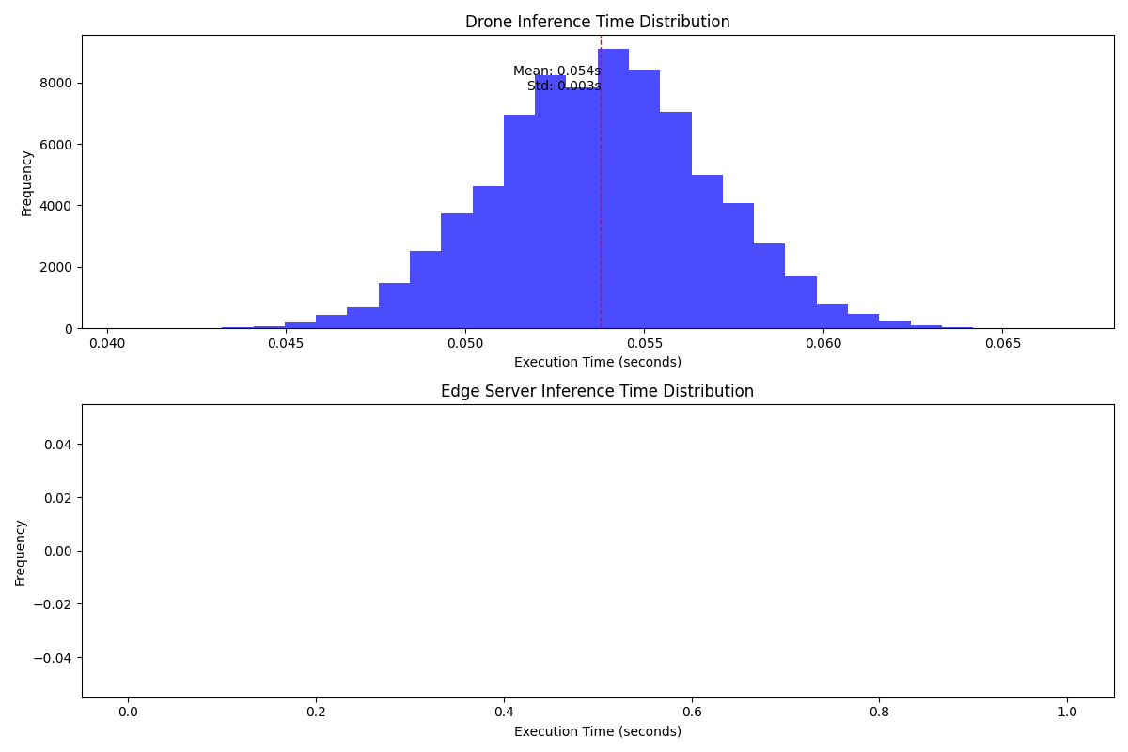
Offloading Rate : 0%
Task Distribution and Success Rates
Computing Node | Number of Tasks (% of Total) | Success Rate (%)
Far-Edge (Drone) | 76500 (100%) | 100.00
Edge Servers | 0 (0.00%) | N/A
Inference Time:
Metric | Drone (Seconds) | Edge Servers (Seconds)
Average Network Time | 0 | N/A
Average Waiting Time | 0 | N/A
Average Execution Time | 0.0538 | N/A
Average Total Time | 0.0538 | N/A
Image Quality Data Transfer Statistics
Quality | Total Offloaded MB
240p | 0
480p | 0
720p | 0
1080p | 0
1440p | 0
2160p | 0
Energy Consumption and CPU Usage Analysis:
Level | Dynamic Consumption (Wh) | CPU Usage (%)
Edge | 0 | N/A
Mist (Drone) | 3.0864 | 20.1729

Slide 6
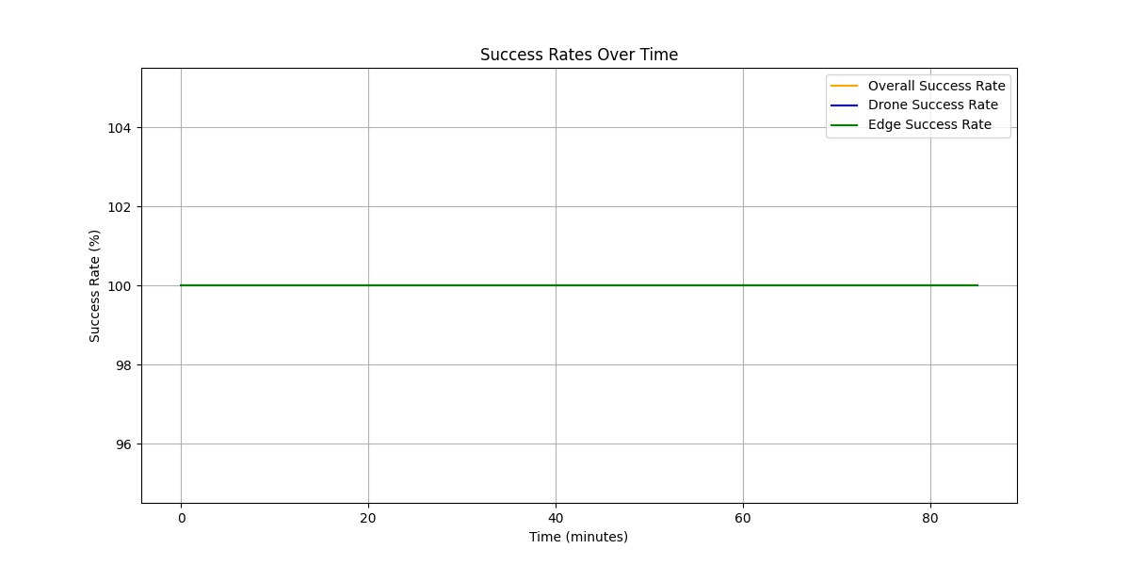
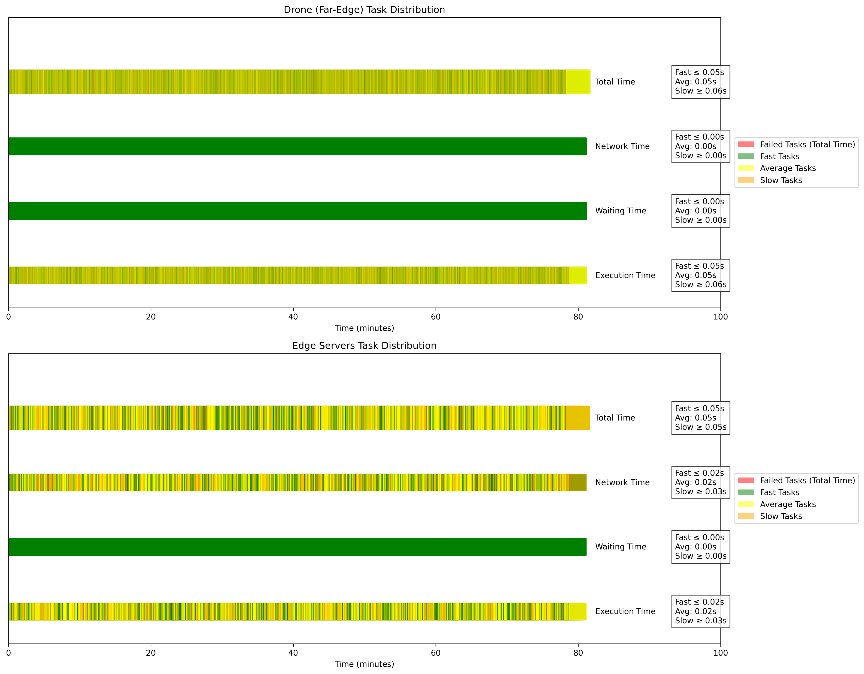
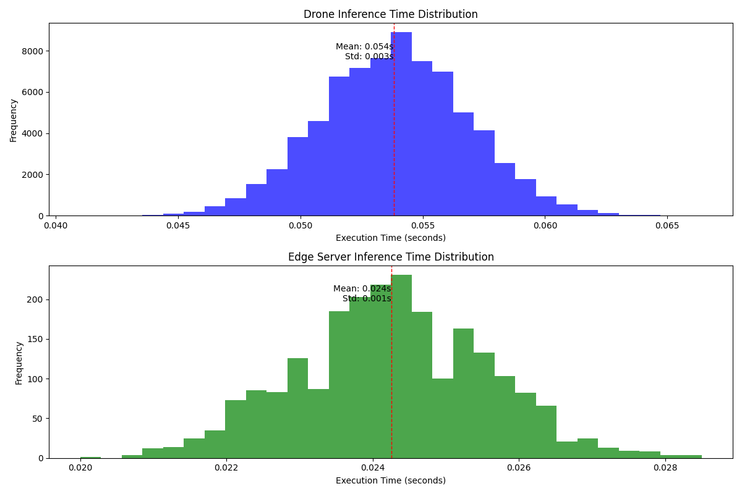
Offloading Rate : 3%
Task Distribution and Success Rates
Computing Node | Number of Tasks (% of Total) | Success Rate (%)
Far-Edge (Drone) | 74203 (97.00%) | 100.00
Edge Servers | 2297 (3.00%) | 100.00
Inference Time:
Metric | Drone (Seconds) | Edge Servers (Seconds)
Average Network Time | 0 | 0.0244
Average Waiting Time | 0 | 0
Average Execution Time | 0.0538 | 0.0243
Average Total Time | 0.0538 | 0.0487
Image Quality Data Transfer Statistics
Quality | Total Offloaded MB
240p | 112.16
480p | 336.47
720p | 785.11
1080p | 1794.53
1440p | 4486.33
2160p | 17945.3
Energy Consumption and CPU Usage Analysis:
Level | Dynamic Consumption (Wh) | CPU Usage (%)
Edge | 0.1238 | 0.039
Mist (Drone) | 3.0062 | 19.5743

Slide 7
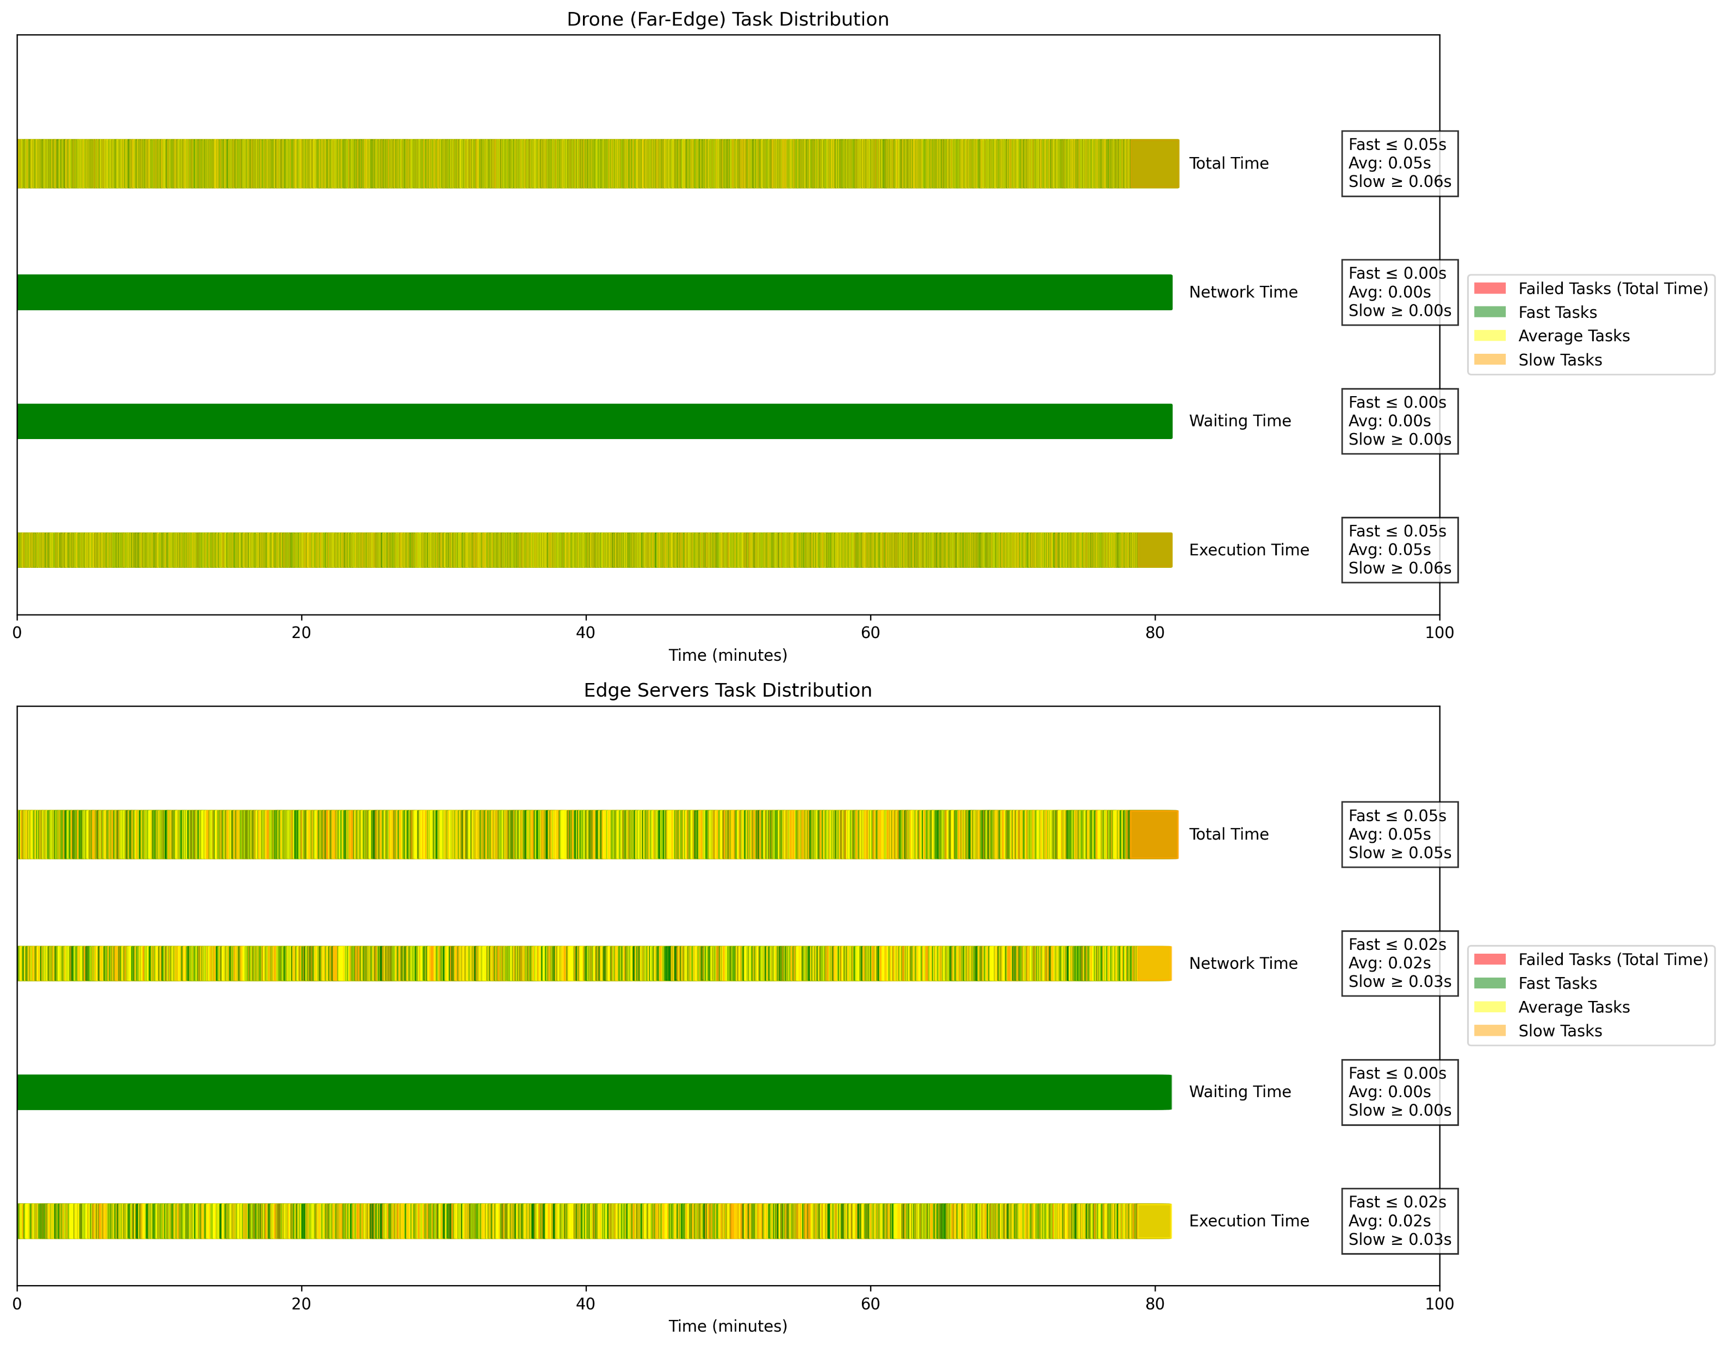
Offloading Rate : 5%
Task Distribution and Success Rates
Computing Node | Number of Tasks (% of Total) | Success Rate (%)
Far-Edge (Drone) | 72699 (95.03%) | 100.00
Edge Servers | 3801 (4.97%) | 100.00
Inference Time:
Metric | Drone (Seconds) | Edge Servers (Seconds)
Average Network Time | 0 | 0.0244
Average Waiting Time | 0 | 0
Average Execution Time | 0.0538 | 0.0242
Average Total Time | 0.0538 | 0.0486
Image Quality Data Transfer Statistics
Quality | Total Offloaded MB
240p | 185.6
480p | 556.79
720p | 1299.17
1080p | 2969.53
1440p | 7423.83
2160p | 29695.3
Energy Consumption and CPU Usage Analysis:
Level | Dynamic Consumption (Wh) | CPU Usage (%)
Edge | 0.2048 | 0.0645
Mist (Drone) | 2.9527 | 19.1769

Slide 8
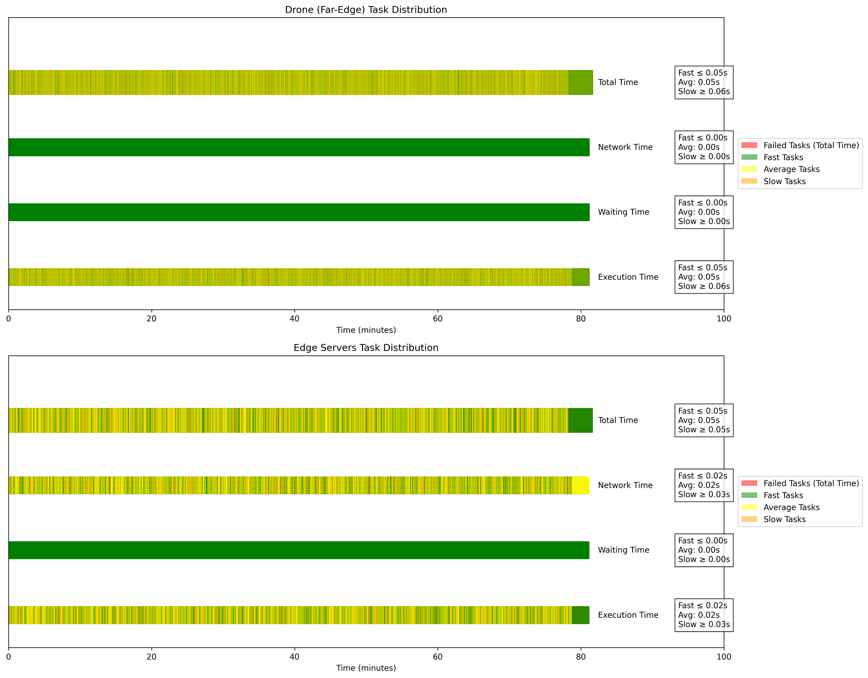
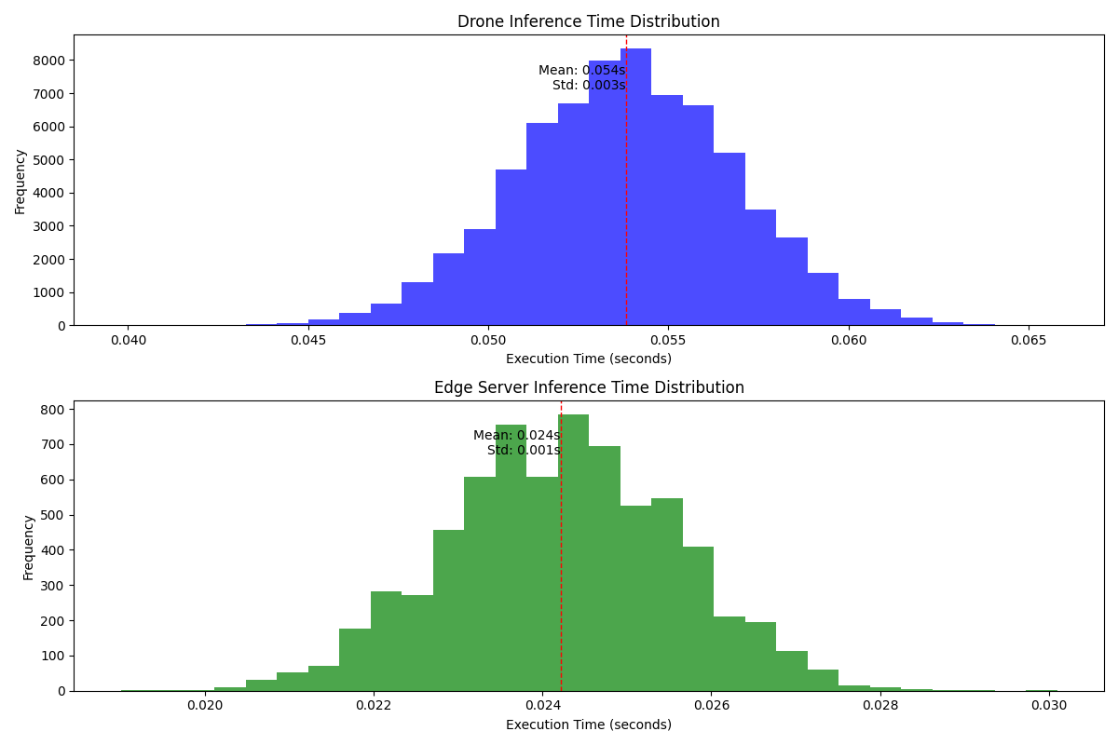
Offloading Rate : 9%
Task Distribution and Success Rates
Computing Node | Number of Tasks (% of Total) | Success Rate (%)
Far-Edge (Drone) | 69599 (90.98%) | 100.00
Edge Servers | 6901 (9.02%) | 100.00
Inference Time:
Metric | Drone (Seconds) | Edge Servers (Seconds)
Average Network Time | 0 | 0.0244
Average Waiting Time | 0 | 0
Average Execution Time | 0.0538 | 0.0242
Average Total Time | 0.0538 | 0.0486
Image Quality Data Transfer Statistics
Quality | Total Offloaded MB
240p | 336.96
480p | 1010.89
720p | 2358.74
1080p | 5391.41
1440p | 13478.5
2160p | 53914.1
Energy Consumption and CPU Usage Analysis:
Level | Dynamic Consumption (Wh) | CPU Usage (%)
Edge | 0.3713 | 0.117
Mist (Drone) | 2.8432 | 18.3616

Slide 9
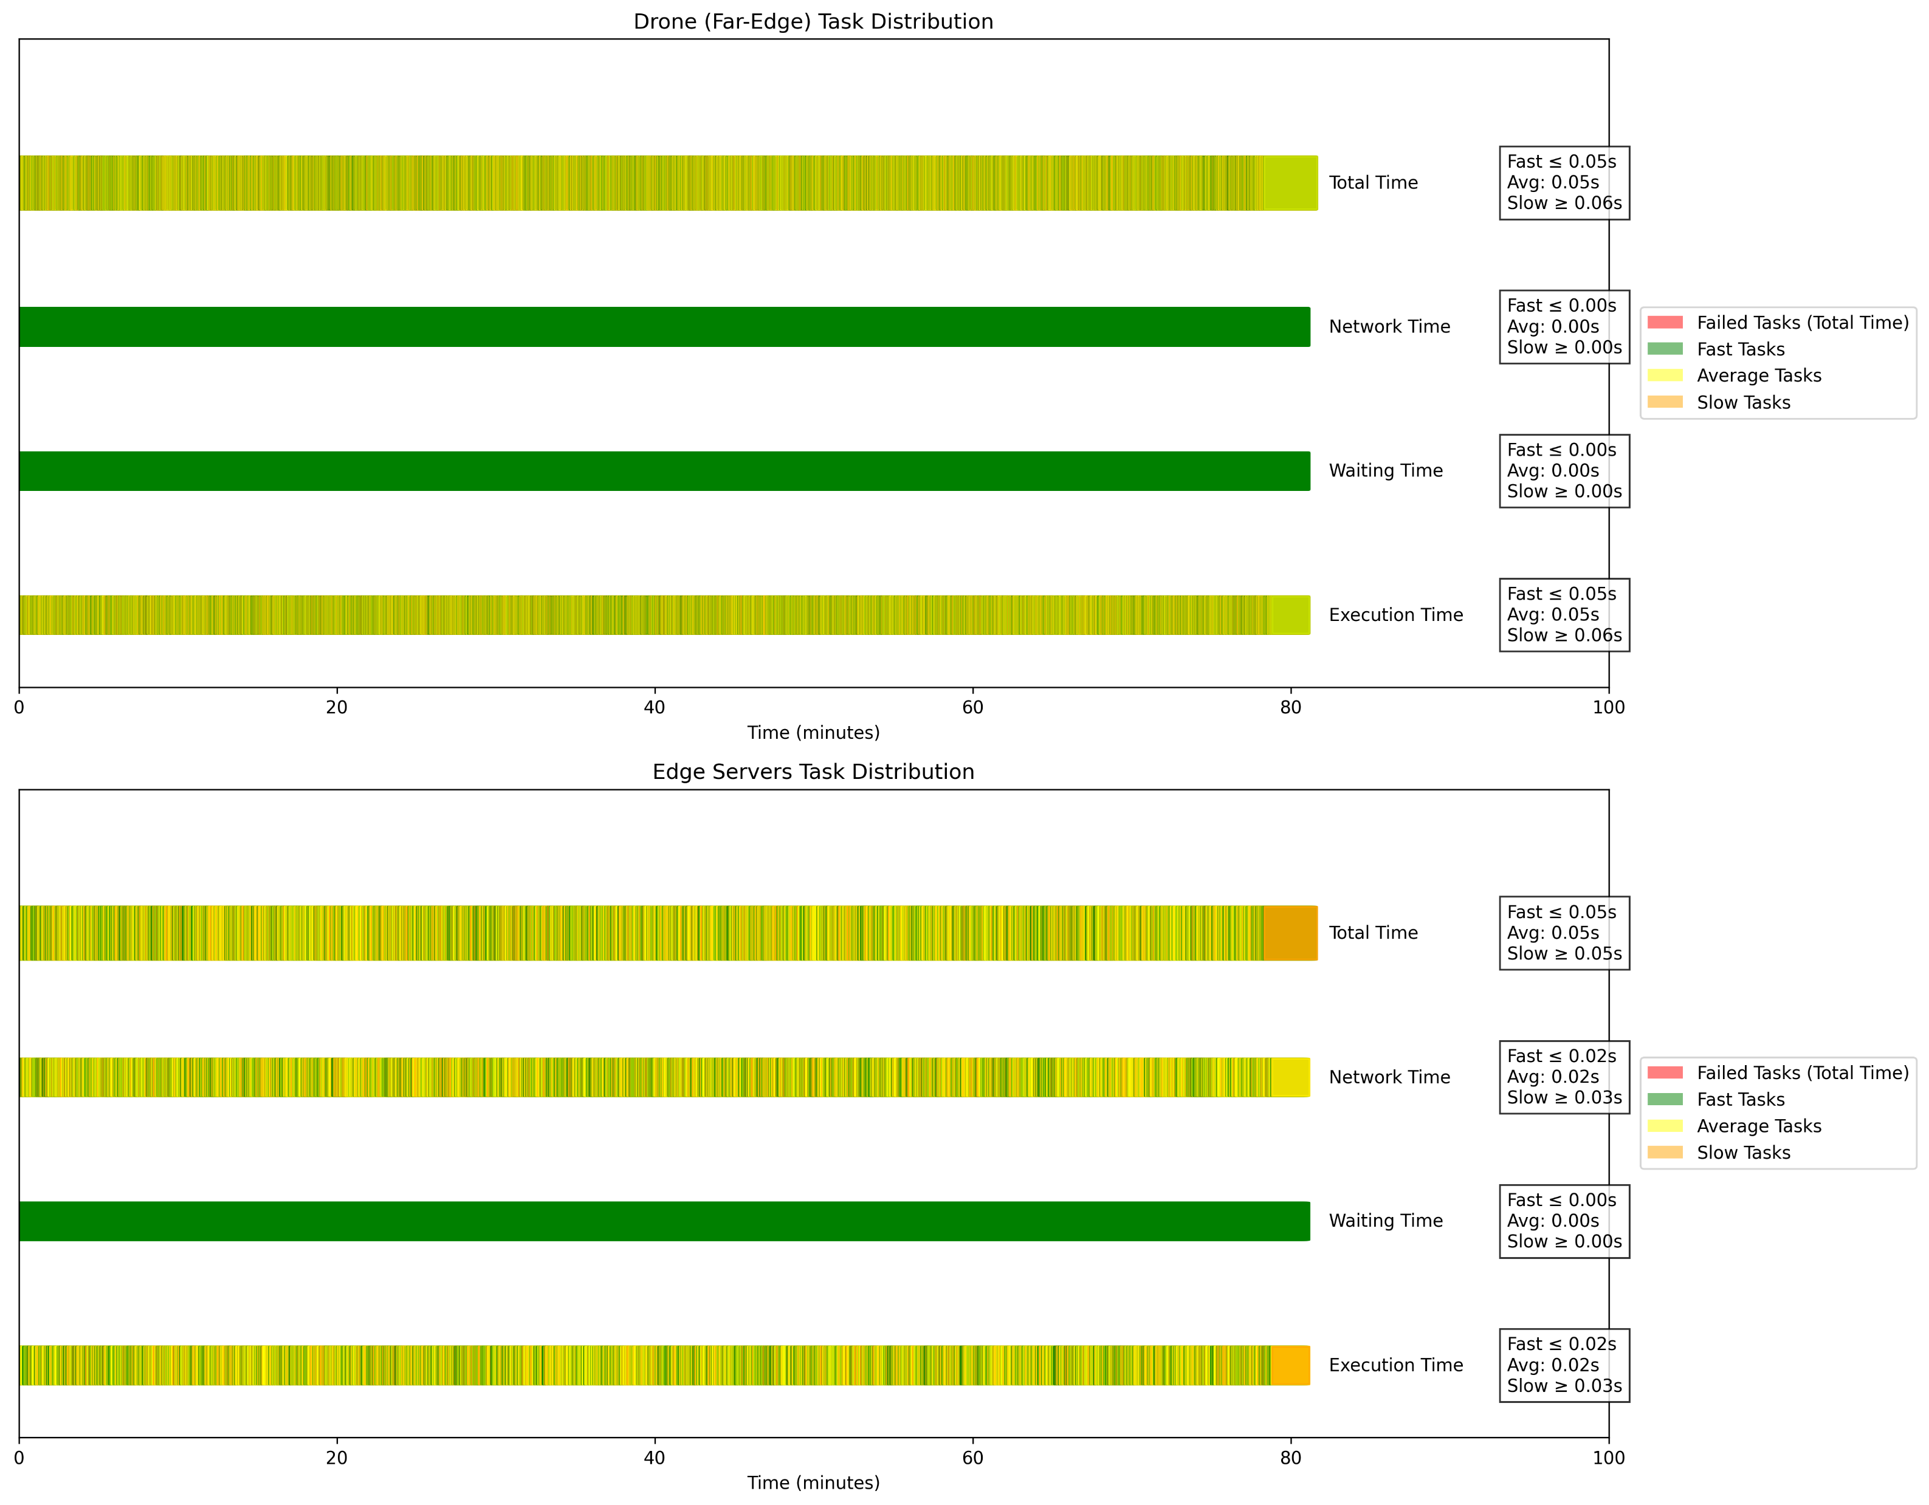
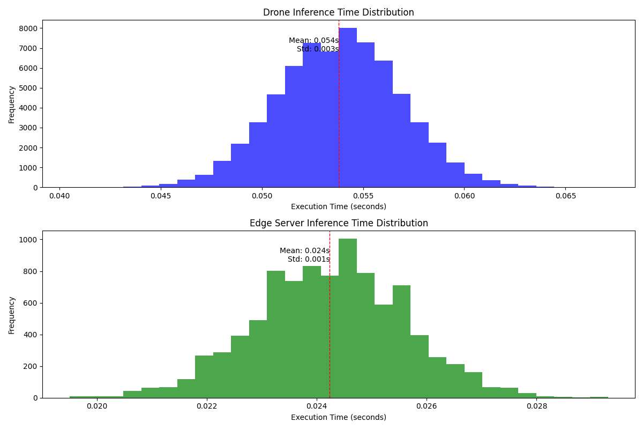
Offloading Rate : 12%
Task Distribution and Success Rates
Computing Node | Number of Tasks (% of Total) | Success Rate (%)
Far-Edge (Drone) | 67302 (87.98%) | 100.00
Edge Servers | 9198 (12.02%) | 100.00
Inference Time:
Metric | Drone (Seconds) | Edge Servers (Seconds)
Average Network Time | 0 | 0.0244
Average Waiting Time | 0 | 0
Average Execution Time | 0.0538 | 0.0242
Average Total Time | 0.0538 | 0.0487
Image Quality Data Transfer Statistics
Quality | Total Offloaded MB
240p | 449.12
480p | 1347.36
720p | 3143.85
1080p | 7185.94
1440p | 17964.8
2160p | 71859.4
Energy Consumption and CPU Usage Analysis:
Level | Dynamic Consumption (Wh) | CPU Usage (%)
Edge | 0.4954 | 0.1561
Mist (Drone) | 2.7612 | 17.7519

Slide 10
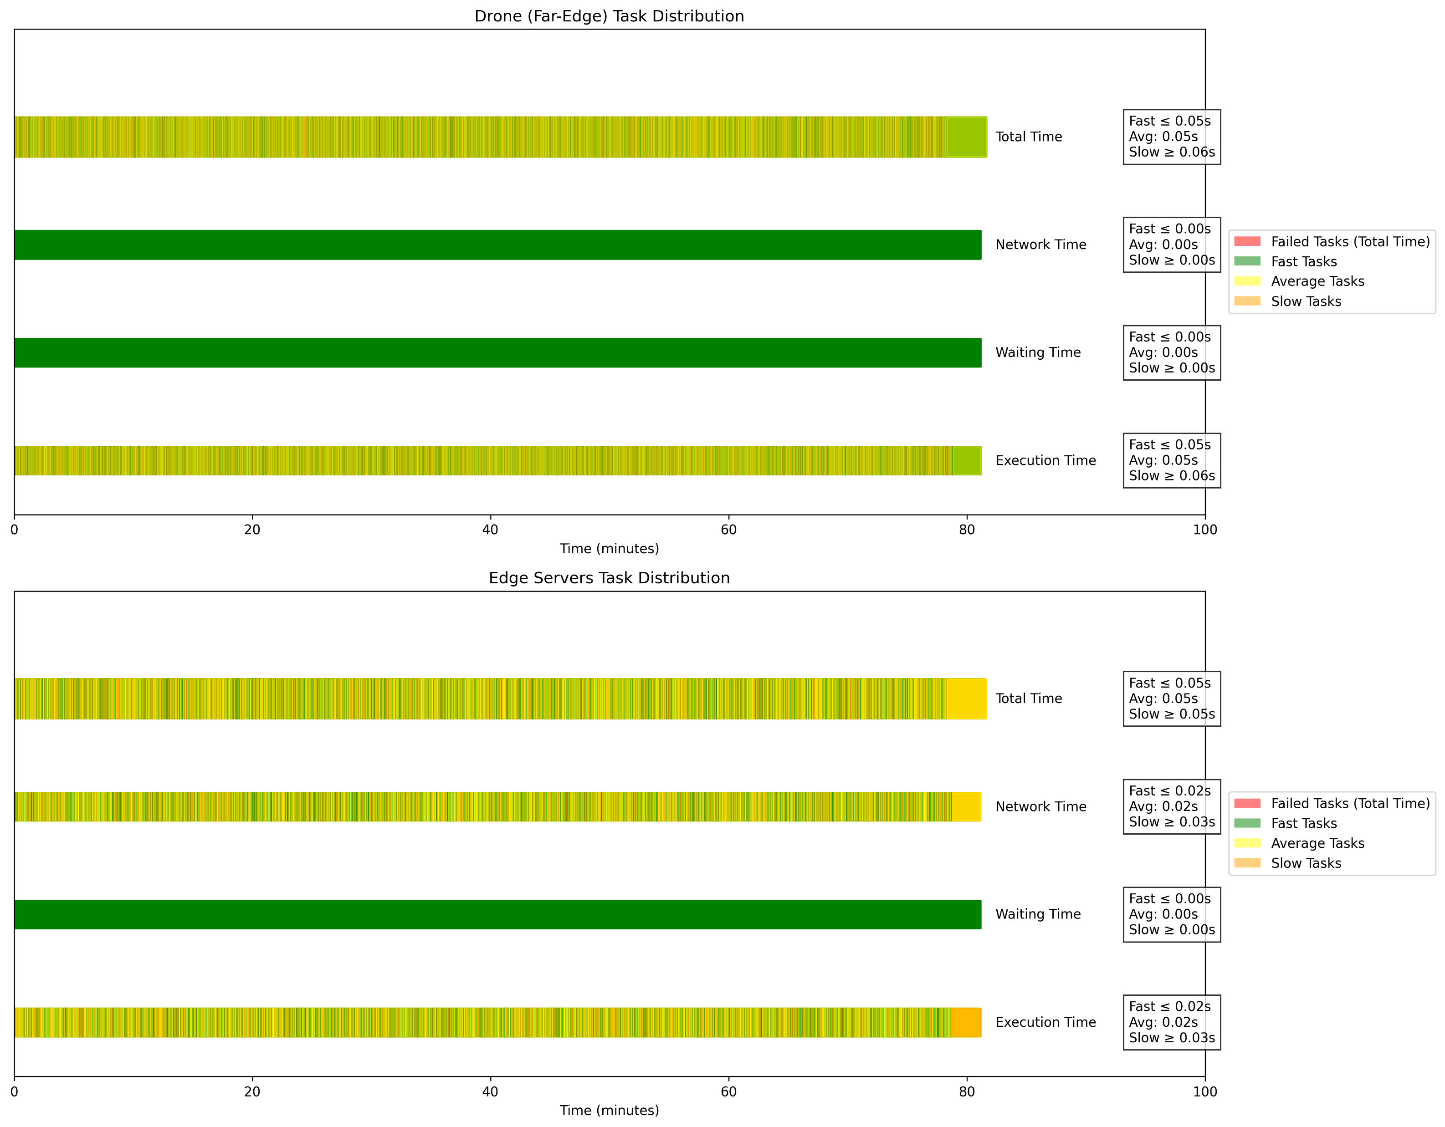
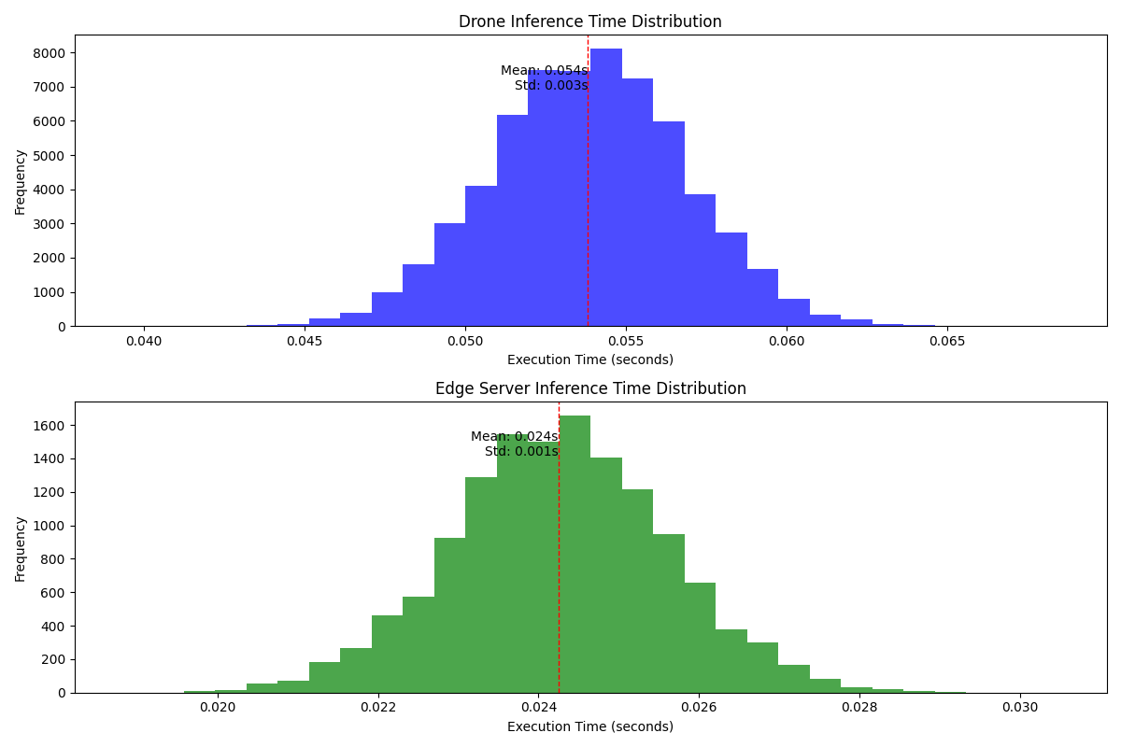
Offloading Rate : 18%
Task Distribution and Success Rates
Computing Node | Number of Tasks (% of Total) | Success Rate (%)
Far-Edge (Drone) | 62724 (81.99%) | 100.00
Edge Servers | 13776 (18.01%) | 100.00
Inference Time:
Metric | Drone (Seconds) | Edge Servers (Seconds)
Average Network Time | 0 | 0.0244
Average Waiting Time | 0 | 0
Average Execution Time | 0.0538 | 0.0242
Average Total Time | 0.0538 | 0.0487
Image Quality Data Transfer Statistics
Quality | Total Offloaded MB
240p | 672.66
480p | 2017.97
720p | 4708.59
1080p | 10762.5
1440p | 26906.2
2160p | 107625
Energy Consumption and CPU Usage Analysis:
Level | Dynamic Consumption (Wh) | CPU Usage (%)
Edge | 0.7423 | 0.2339
Mist (Drone) | 2.5993 | 16.5465

Slide 11
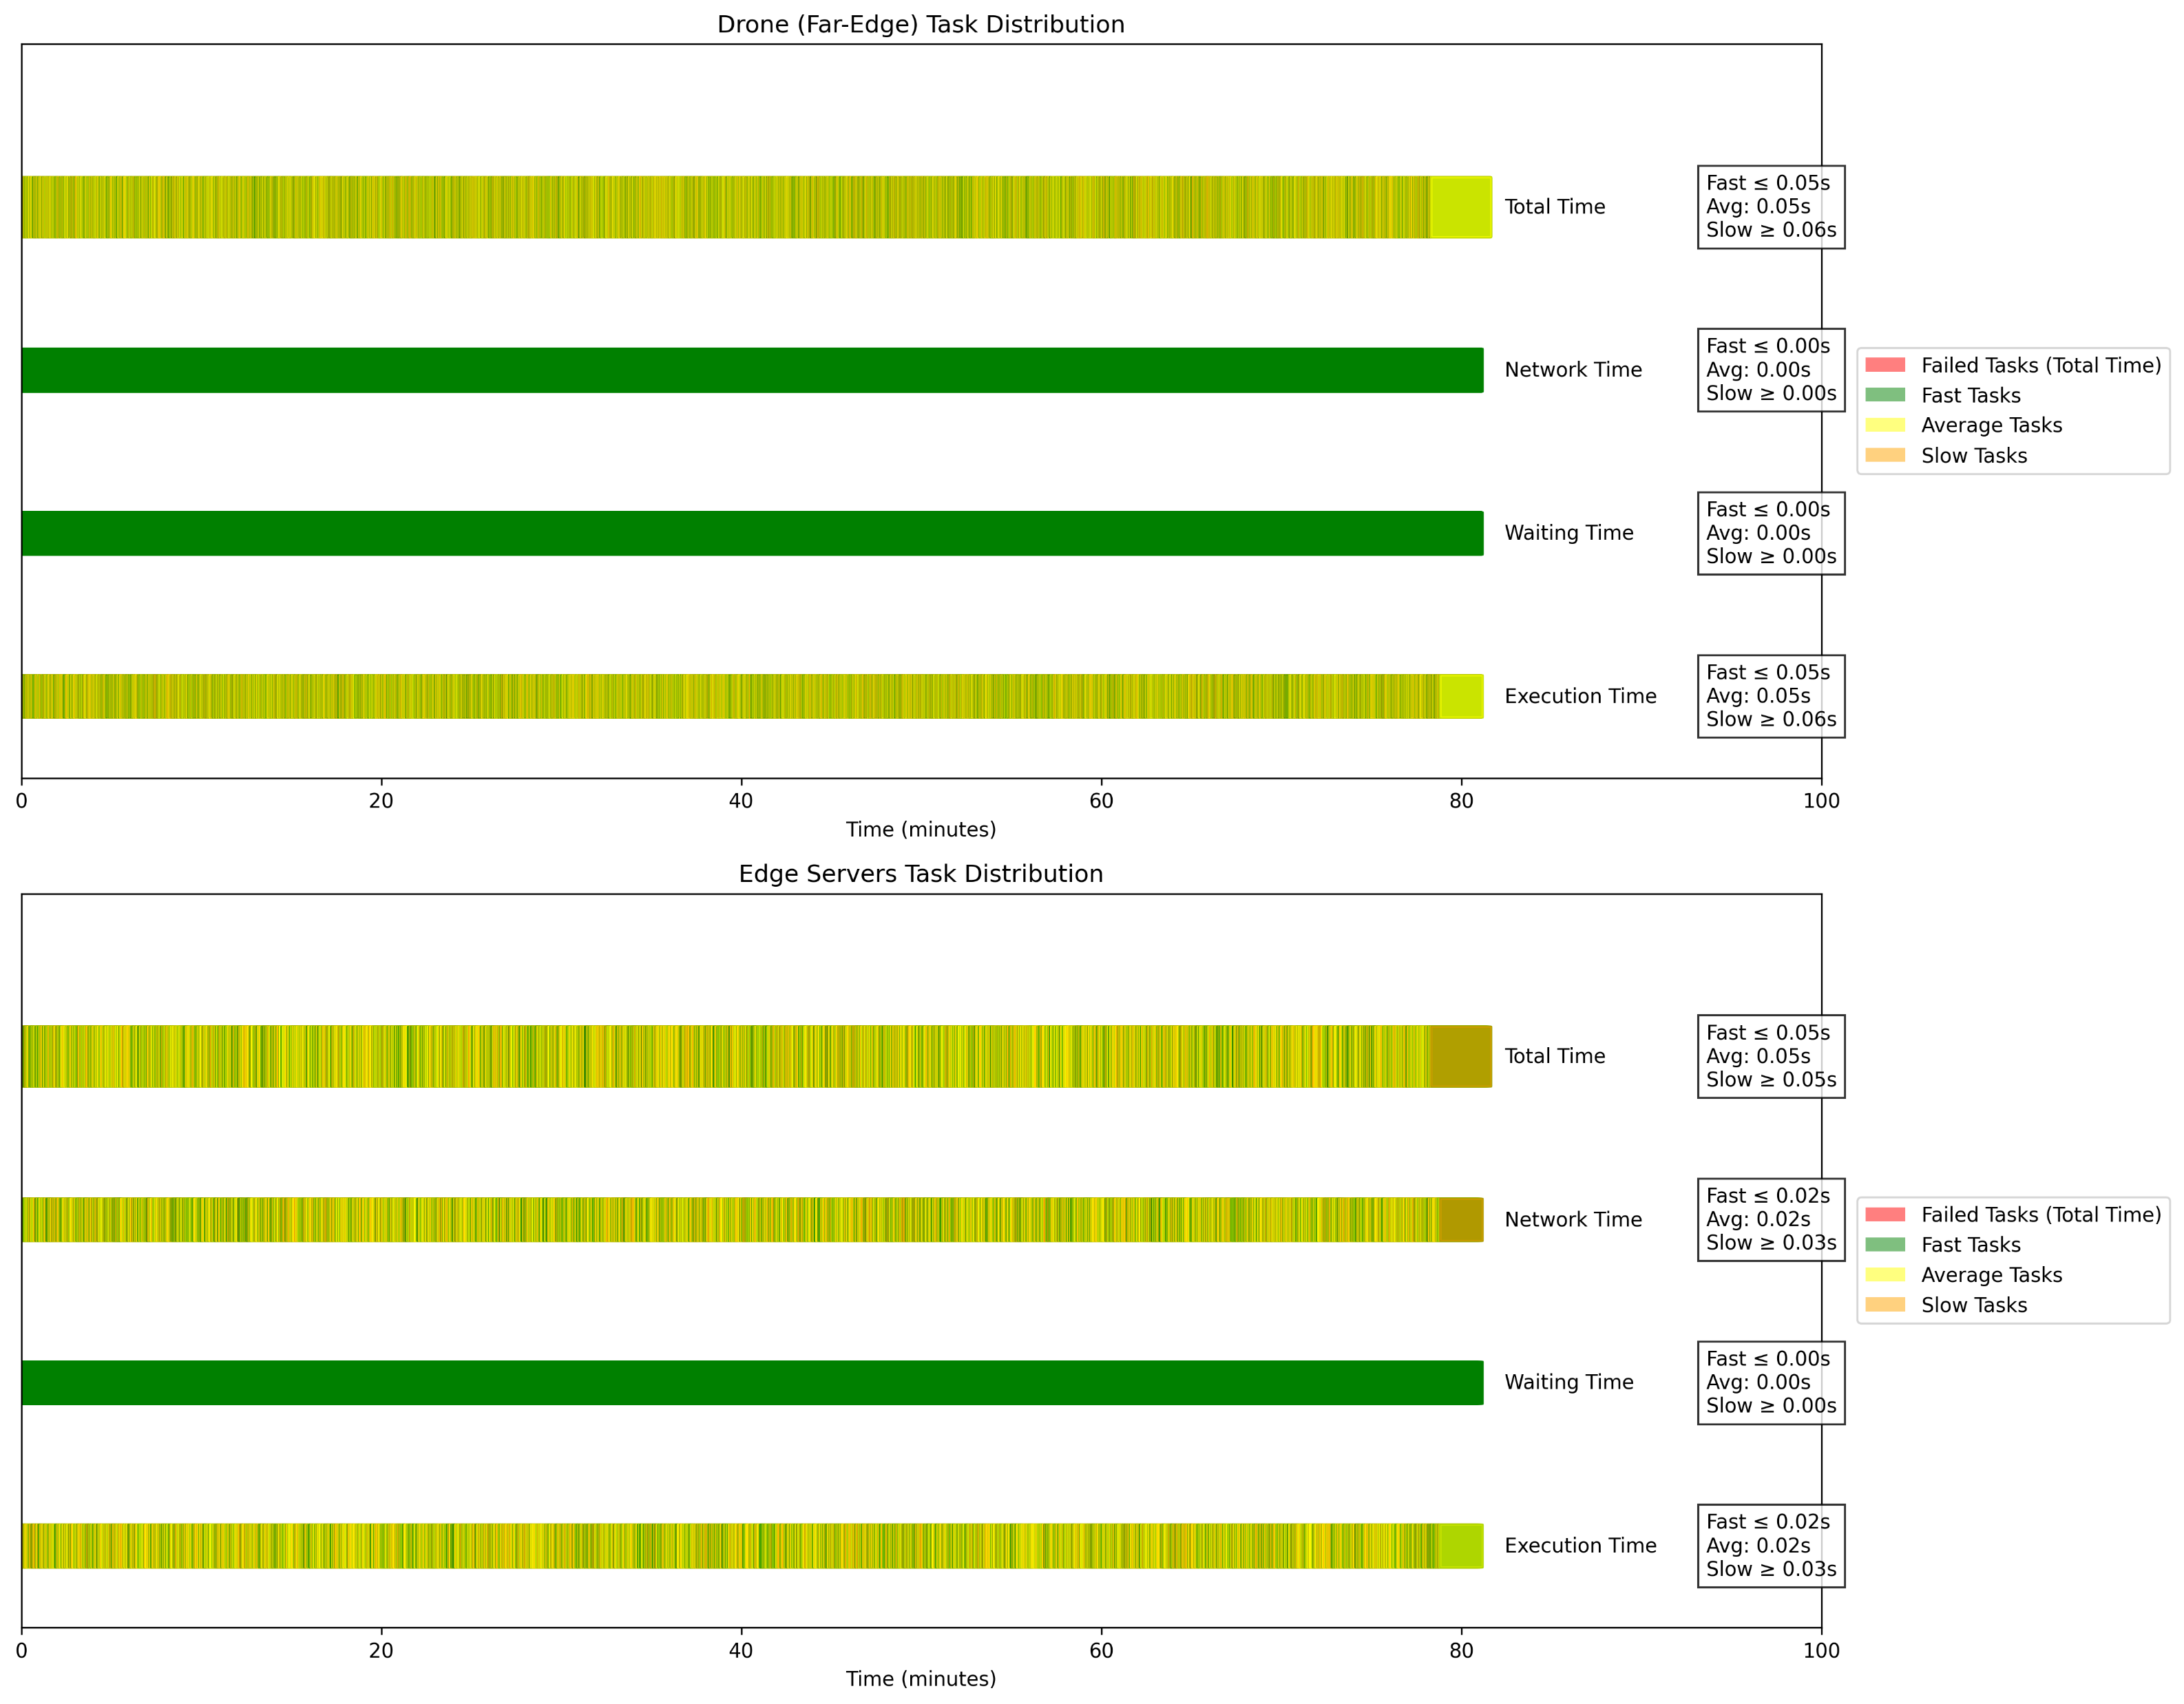
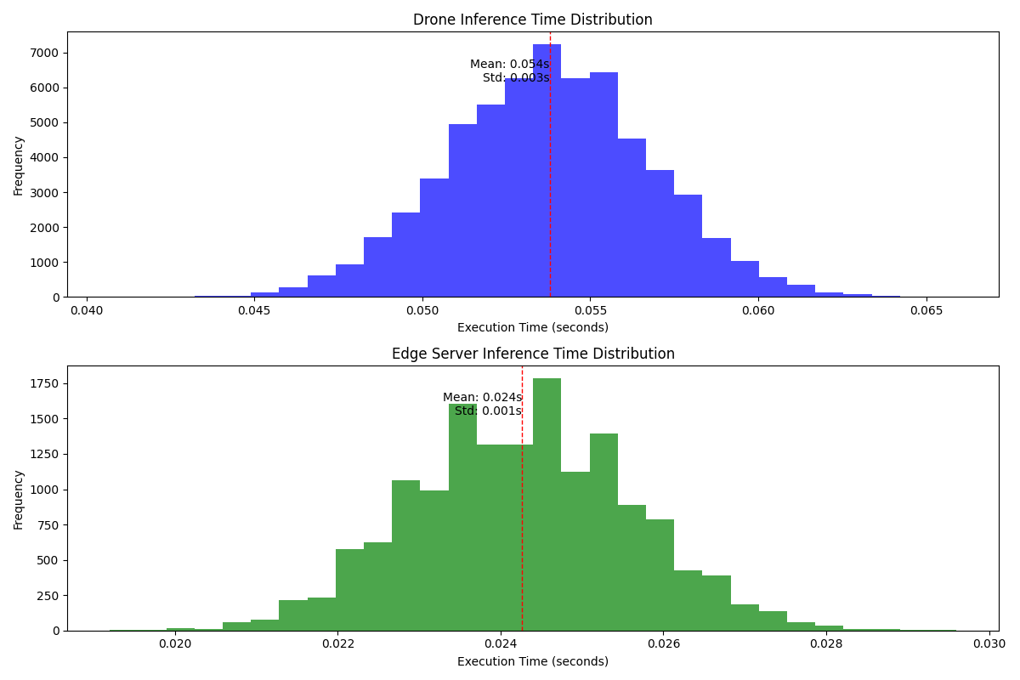
Offloading Rate : 20%
Task Distribution and Success Rates
Computing Node | Number of Tasks (% of Total) | Success Rate (%)
Far-Edge (Drone) | 61161 (79.95%) | 100.00
Edge Servers | 15339 (20.05%) | 100.00
Inference Time:
Metric | Drone (Seconds) | Edge Servers (Seconds)
Average Network Time | 0 | 0.0245
Average Waiting Time | 0 | 0
Average Execution Time | 0.0538 | 0.0243
Average Total Time | 0.0538 | 0.0487
Image Quality Data Transfer Statistics
Quality | Total Offloaded MB
240p | 748.97
480p | 2246.92
720p | 5242.82
1080p | 11983.6
1440p | 29959
2160p | 119836
Energy Consumption and CPU Usage Analysis:
Level | Dynamic Consumption (Wh) | CPU Usage (%)
Edge | 0.827 | 0.2606
Mist (Drone) | 2.5434 | 16.1273

Slide 12
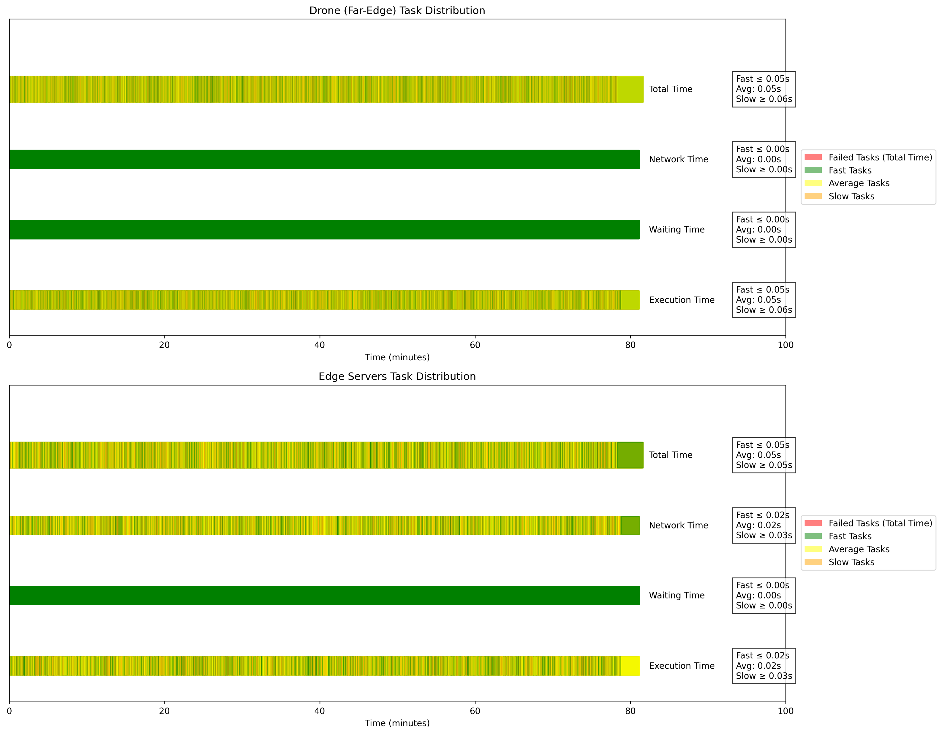
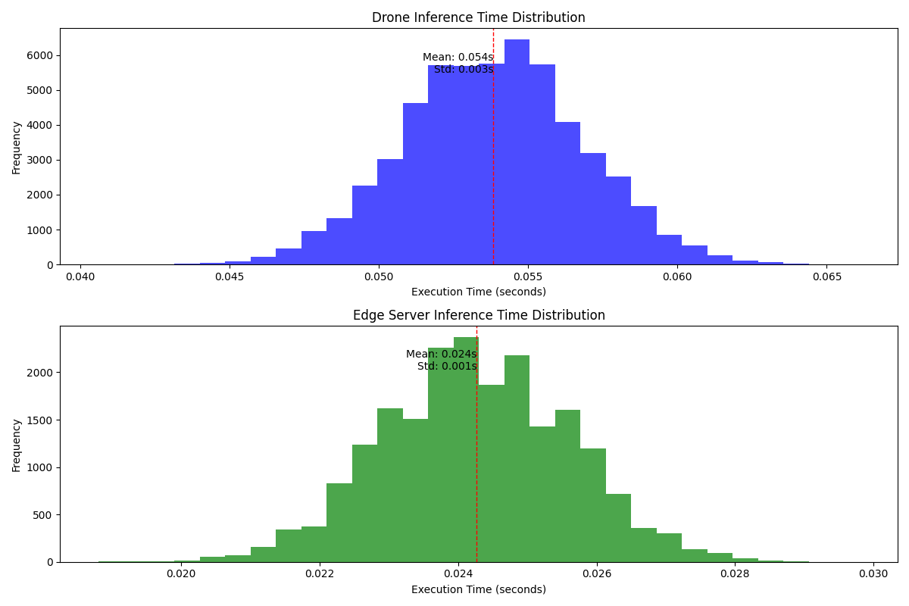
Offloading Rate : 27%
Task Distribution and Success Rates
Computing Node | Number of Tasks (% of Total) | Success Rate (%)
Far-Edge (Drone) | 55712 (72.83%) | 100.00
Edge Servers | 20788 (27.17%) | 100.00
Inference Time:
Metric | Drone (Seconds) | Edge Servers (Seconds)
Average Network Time | 0 | 0.0244
Average Waiting Time | 0 | 0
Average Execution Time | 0.0538 | 0.0243
Average Total Time | 0.0538 | 0.0487
Image Quality Data Transfer Statistics
Quality | Total Offloaded MB
240p | 1015.04
480p | 3045.12
720p | 7105.27
1080p | 16240.6
1440p | 40601.6
2160p | 162406
Energy Consumption and CPU Usage Analysis:
Level | Dynamic Consumption (Wh) | CPU Usage (%)
Edge | 1.1211 | 0.3533
Mist (Drone) | 2.3513 | 14.7016

Slide 13
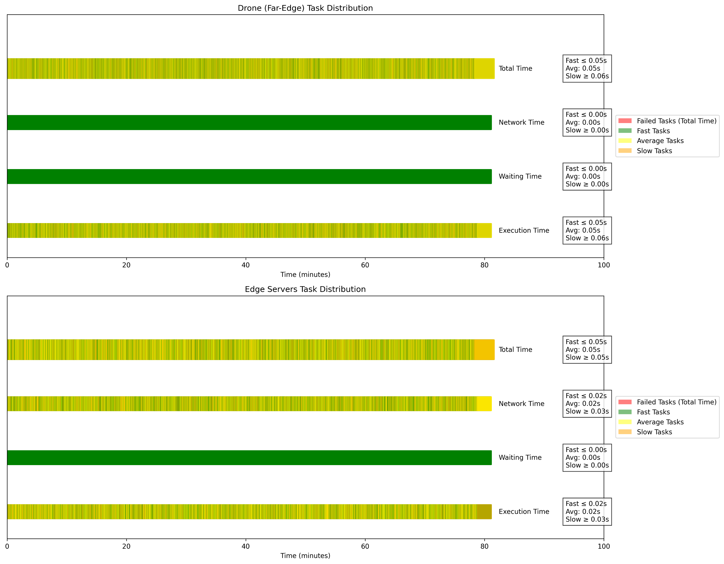
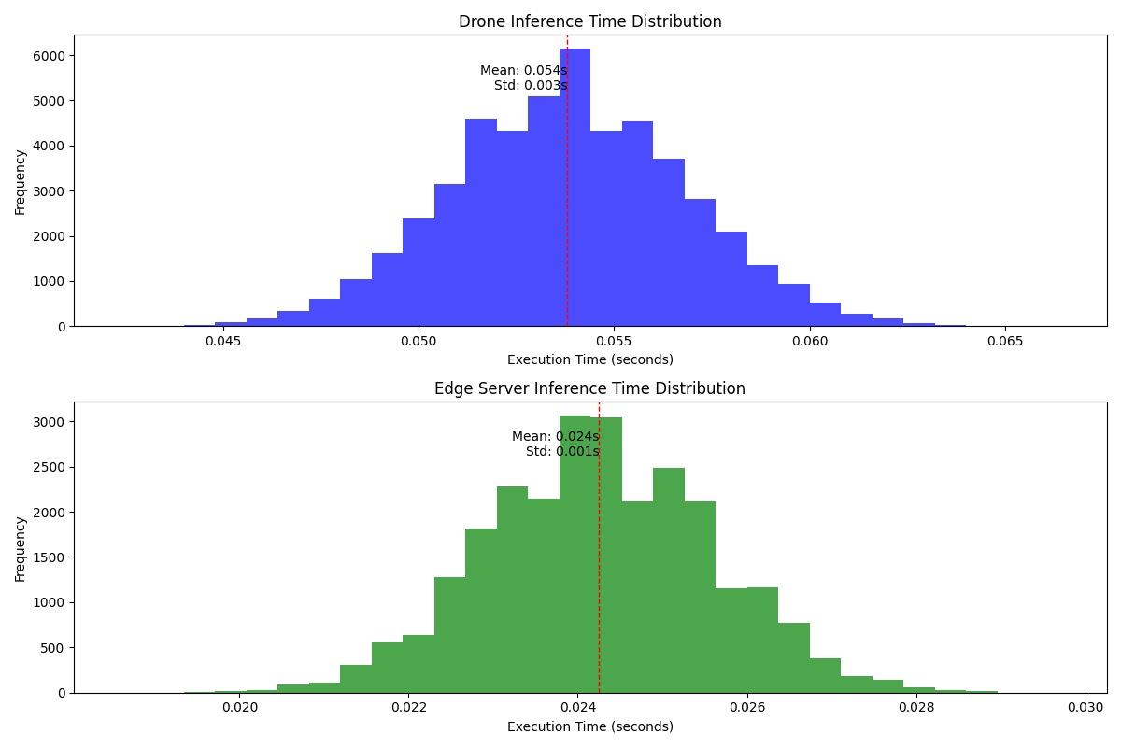
Offloading Rate : 34%
Task Distribution and Success Rates
Computing Node | Number of Tasks (% of Total) | Success Rate (%)
Far-Edge (Drone) | 50482 (65.99%) | 100.00
Edge Servers | 26018 (34.01%) | 100.00
Inference Time:
Metric | Drone (Seconds) | Edge Servers (Seconds)
Average Network Time | 0 | 0.0244
Average Waiting Time | 0 | 0
Average Execution Time | 0.0538 | 0.0243
Average Total Time | 0.0538 | 0.0487
Image Quality Data Transfer Statistics
Quality | Total Offloaded MB
240p | 1270.41
480p | 3811.23
720p | 8892.87
1080p | 20326.6
1440p | 203266
2160p | 162406
Energy Consumption and CPU Usage Analysis:
Level | Dynamic Consumption (Wh) | CPU Usage (%)
Edge | 1.4022 | 0.4419
Mist (Drone) | 2.1656 | 13.3164

Slide 14
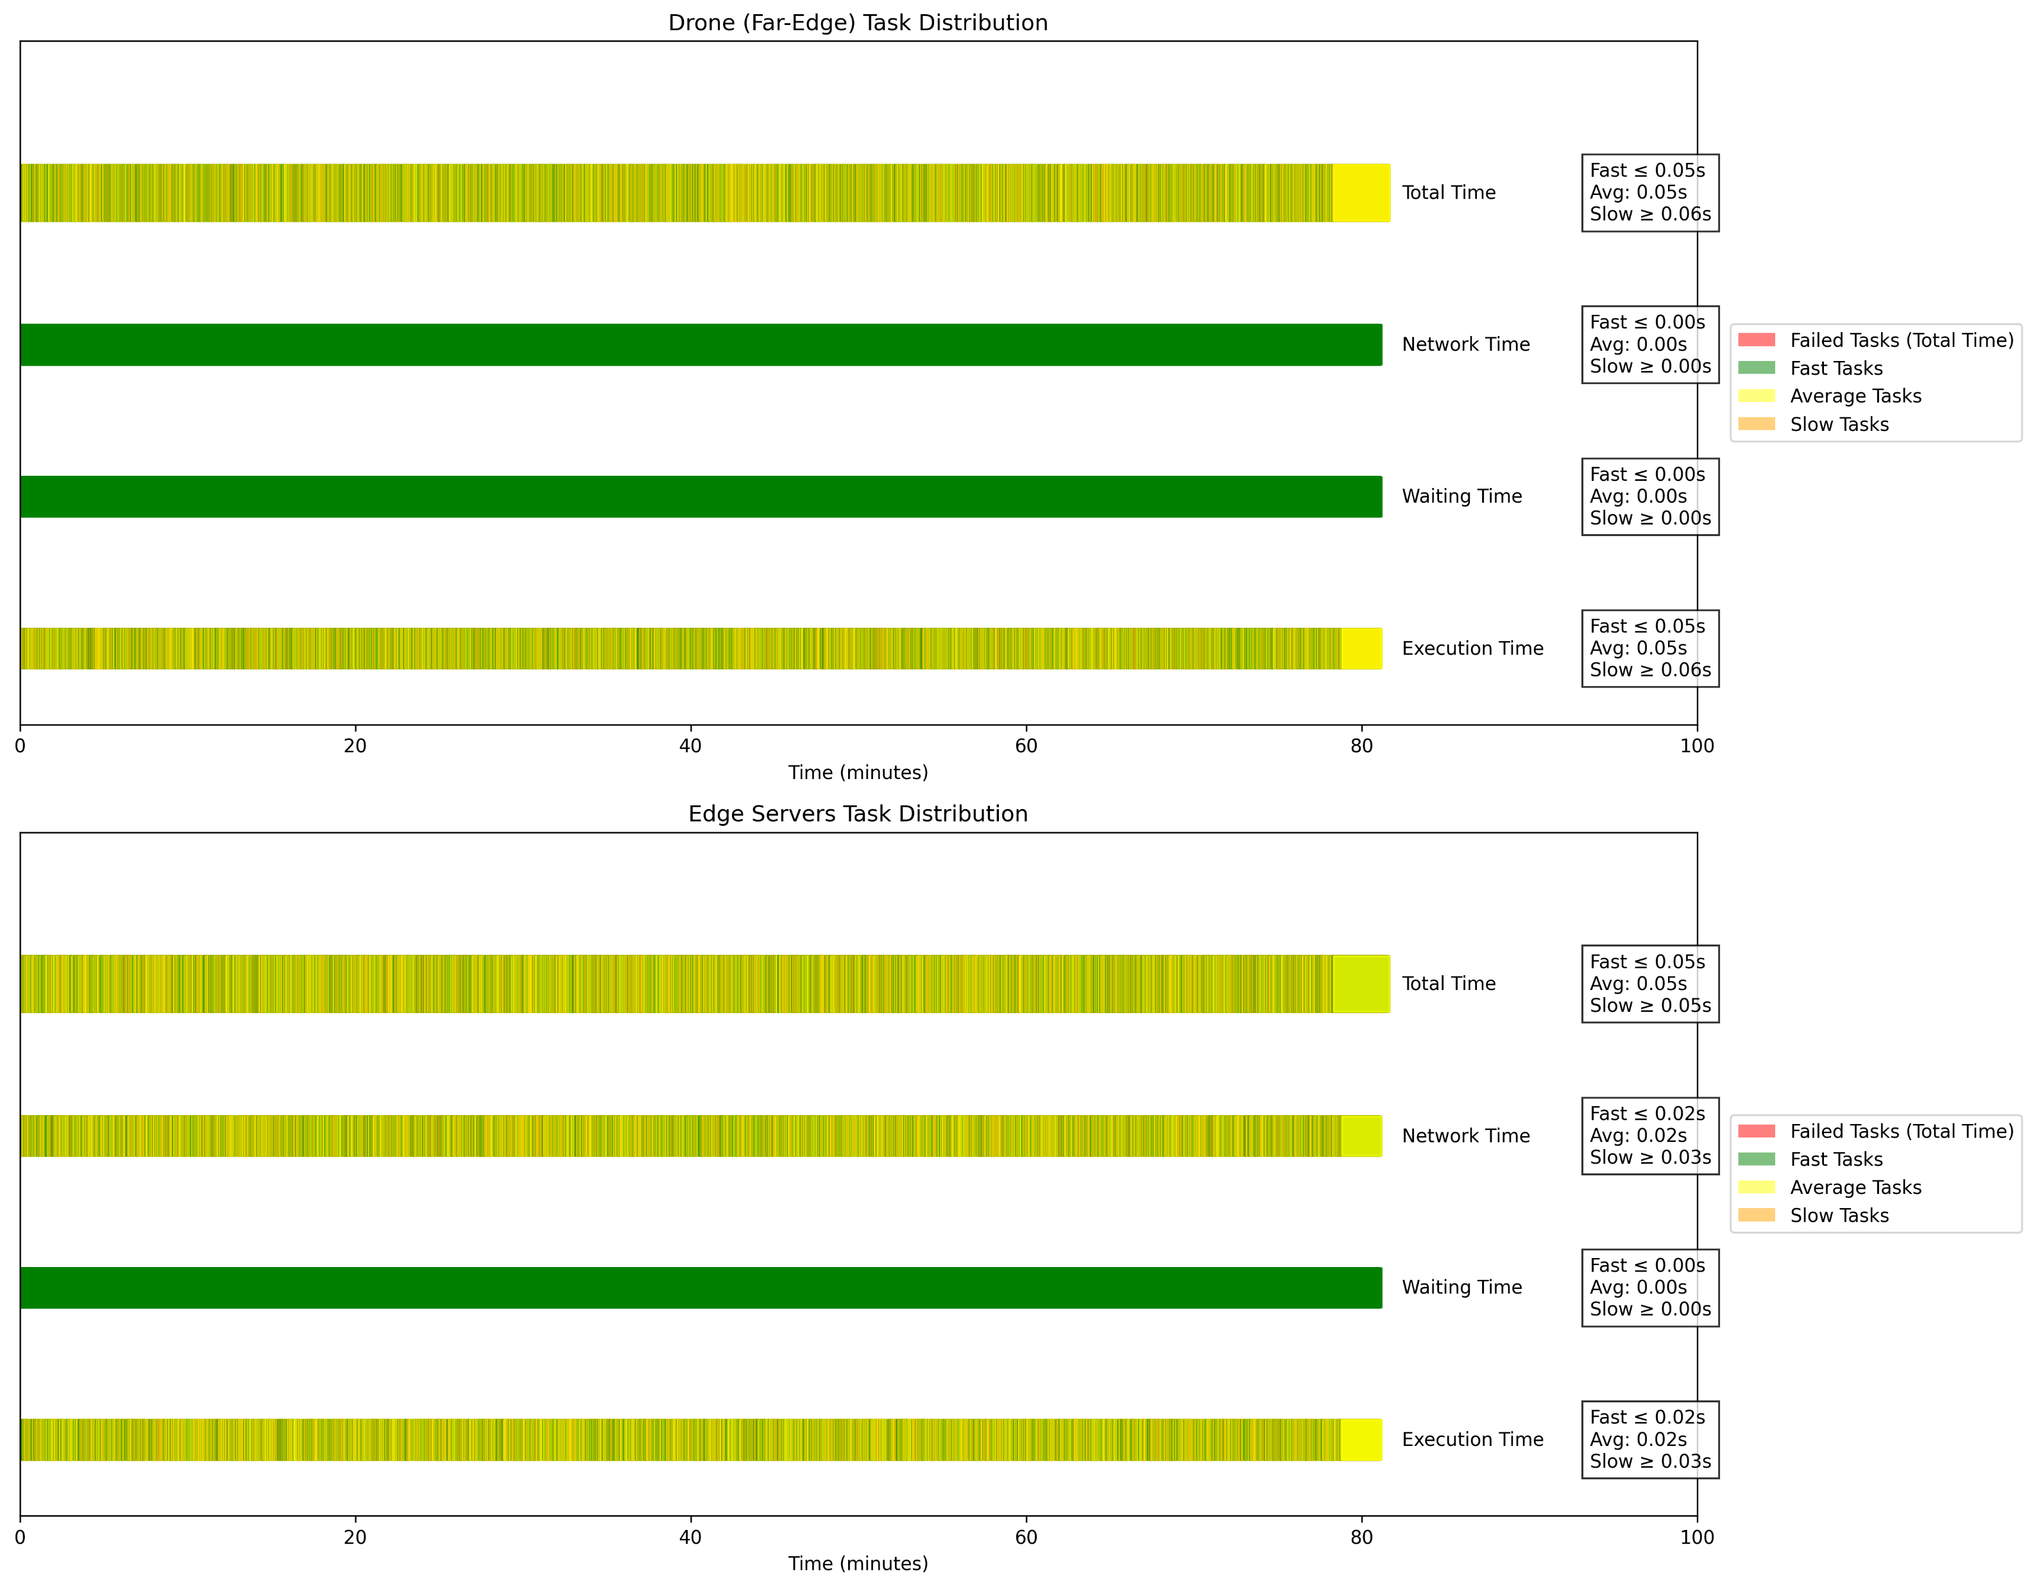
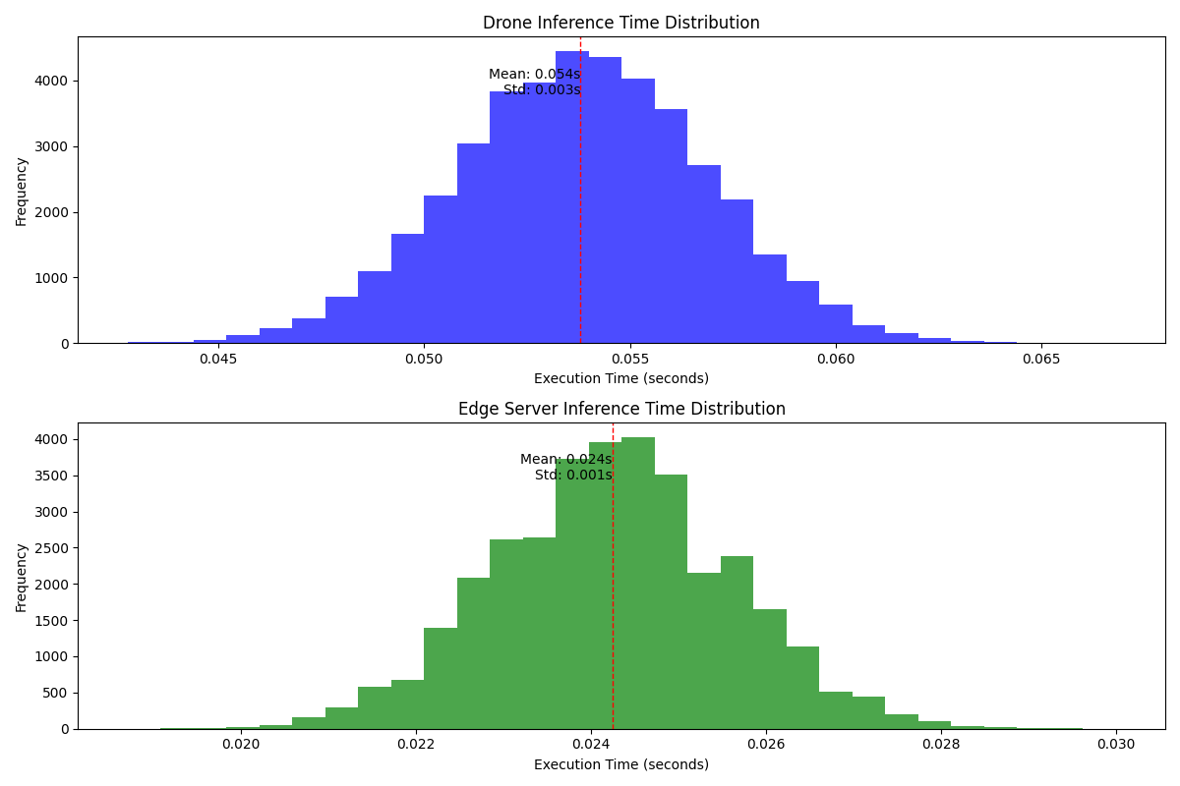
Offloading Rate : 45%
Task Distribution and Success Rates
Computing Node | Number of Tasks (% of Total) | Success Rate (%)
Far-Edge (Drone) | 42087 (55.02%) | 100.00
Edge Servers | 34413 (44.98%) | 100.00
Inference Time:
Metric | Drone (Seconds) | Edge Servers (Seconds)
Average Network Time | 0 | 0.0244
Average Waiting Time | 0 | 0
Average Execution Time | 0.0538 | 0.0242
Average Total Time | 0.0538 | 0.0487
Image Quality Data Transfer Statistics
Quality | Total Offloaded MB
240p | 1680.32
480p | 5040.97
720p | 11762.3
1080p | 26885.2
1440p | 2688529
2160p | 203266
Energy Consumption and CPU Usage Analysis:
Level | Dynamic Consumption (Wh) | CPU Usage (%)
Edge | 1.854 | 0.5842
Mist (Drone) | 1.8672 | 11.0999

Slide 15
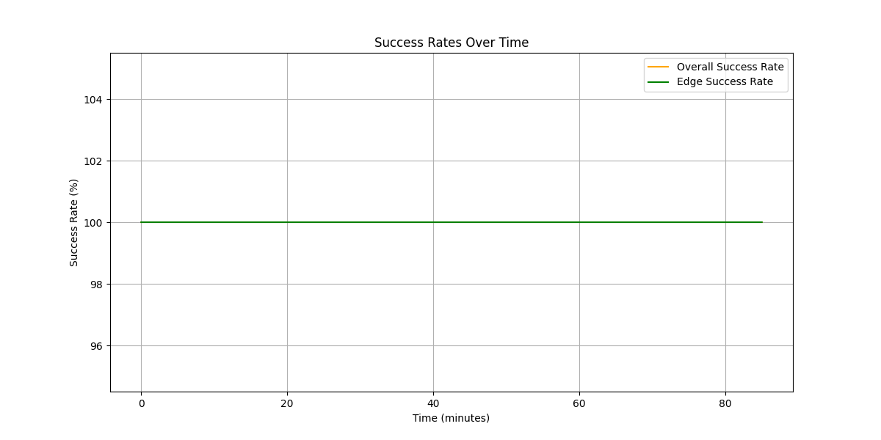
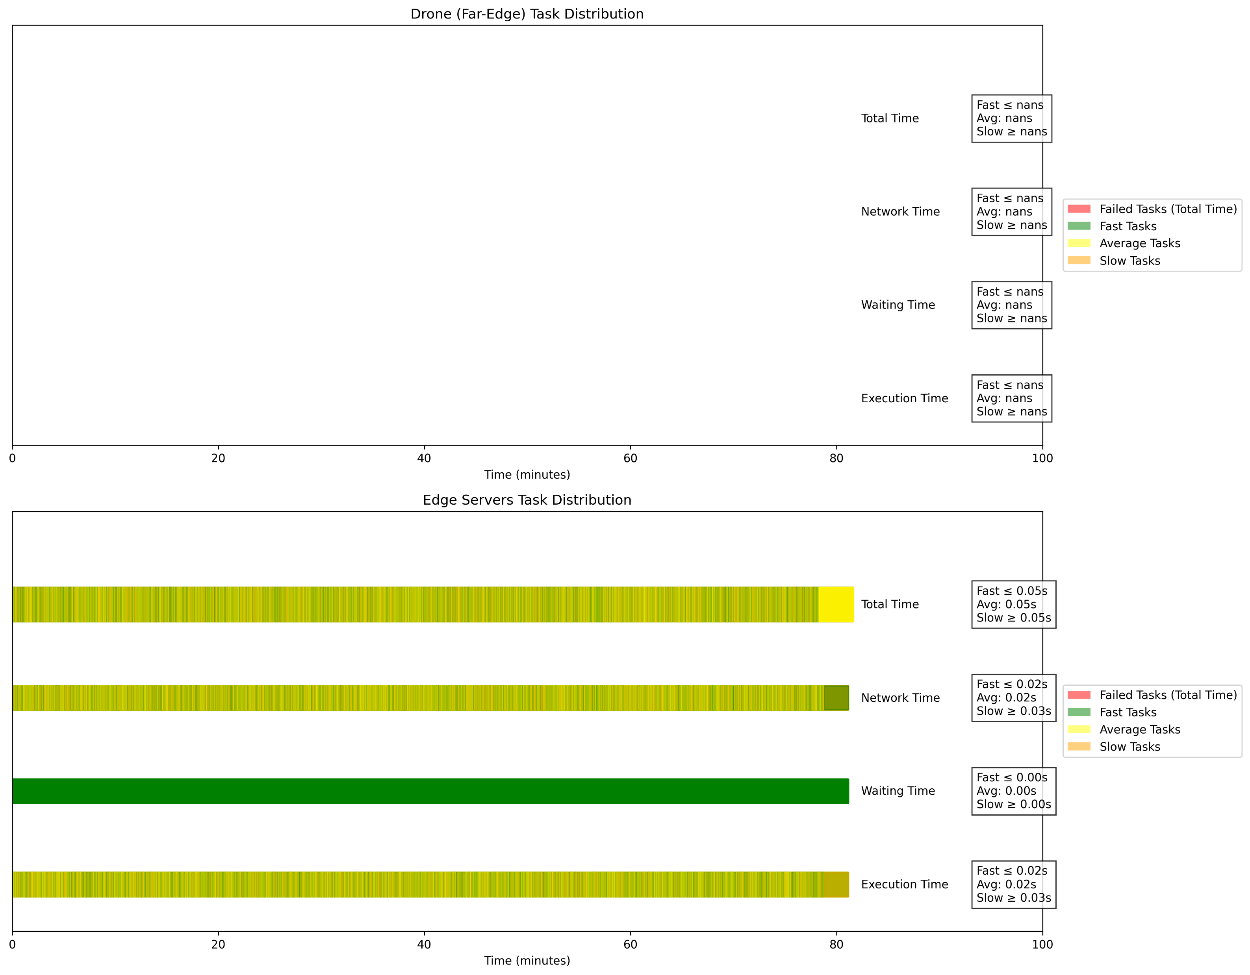
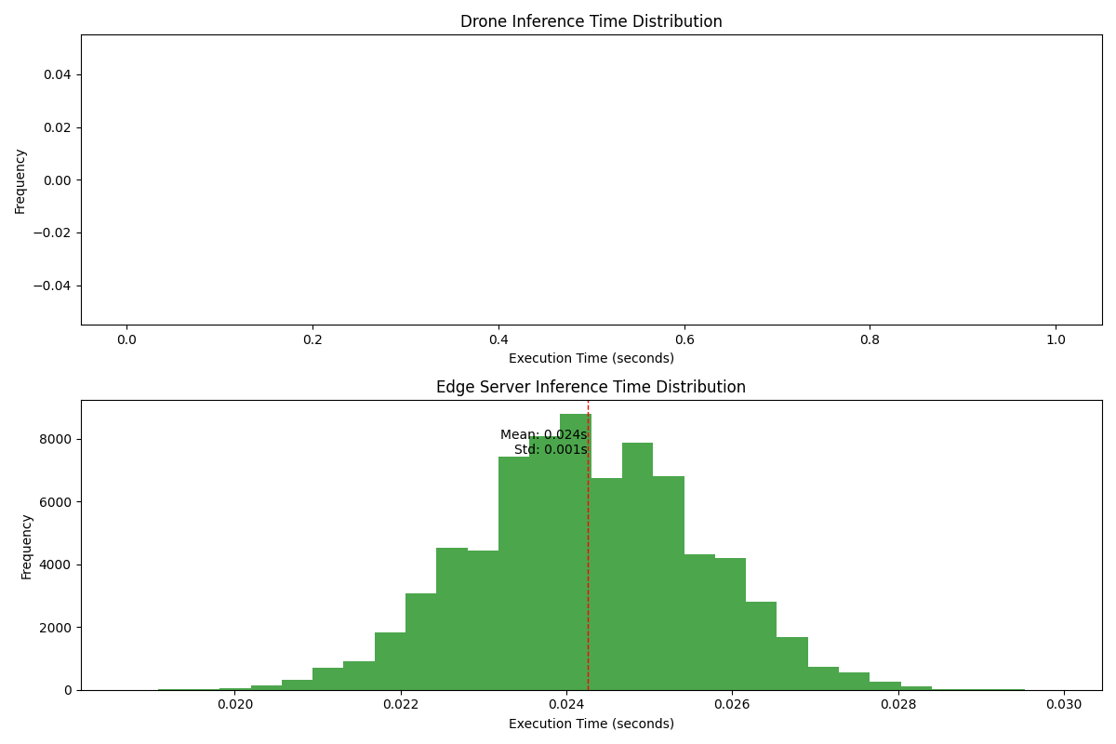
Offloading Rate : 100%
Task Distribution and Success Rates
Computing Node | Number of Tasks (% of Total) | Success Rate (%)
Far-Edge (Drone) | 0 (0.00%) | N/A
Edge Servers | 76500 (100.00%) | 100.00
Inference Time:
Metric | Drone (Seconds) | Edge Servers (Seconds)
Average Network Time | N/A | 0.0244
Average Waiting Time | N/A | 0
Average Execution Time | N/A | 0.0243
Average Total Time | N/A | 0.0487
Image Quality Data Transfer Statistics
Quality | Total Offloaded MB
240p | 3735.35
480p | 11206
720p | 26147.5
1080p | 59765.6
1440p | 149414
2160p | 597656
Energy Consumption and CPU Usage Analysis:
Level | Dynamic Consumption (Wh) | CPU Usage (%)
Edge | 4.1231 | 1.2993
Mist (Drone) | 0.376 | 0

Slide 16
Summary
For one Drone the simulation result summary is:
Scenario Name | Offloading Rate (%) | Average CPU Utilization (%) |  | Dynamic Energy Consumption (Wh) |  | Success Rate (%) |  | Drone Average Total Time (s) | Edge Average Total Time (s) | Total Offloaded Data (MB)
 |  | Drone | Edge | Drone | Edge | Drone | Edge |  |  | 240p | 480p | 720p | 1080p | 1440p | 2160p
 |  | Drone | Edge | Drone | Edge | Drone | Edge
50% | 0% | 20.1729 | 0 | 3.0864 | 0 | 100 | N/A | 0.0538 | N/A | 0 | 0 | 0 | 0 | 0 | 0
55% | 3% | 19.5743 | 0.039 | 3.0062 | 0.1238 | 100 | 100 | 0.0538 | 0.0487 | 112.16 | 336.47 | 785.11 | 1794.53 | 4486.33 | 17945.3
60% | 5% | 19.1769 | 0.0645 | 2.9527 | 0.2048 | 100 | 100 | 0.0538 | 0.0486 | 185.6 | 556.79 | 1299.17 | 2969.53 | 7423.83 | 29695.3
65% | 9% | 18.3616 | 0.117 | 2.8432 | 0.3713 | 100 | 100 | 0.0538 | 0.0486 | 336.96 | 1010.89 | 2358.74 | 5391.41 | 13478.5 | 53914.1
70% | 12% | 17.7519 | 0.1561 | 2.7612 | 0.4954 | 100 | 100 | 0.0538 | 0.0487 | 449.12 | 1347.36 | 3143.85 | 7185.94 | 17964.8 | 71859.4
75% | 18% | 16.5465 | 0.2339 | 2.5993 | 0.7423 | 100 | 100 | 0.0538 | 0.0487 | 672.66 | 2017.97 | 4708.59 | 10762.5 | 26906.2 | 107625
80% | 20% | 16.1273 | 0.2606 | 2.5434 | 0.827 | 100 | 100 | 0.0538 | 0.0487 | 748.97 | 2246.92 | 5242.82 | 11983.6 | 29959 | 119836
85% | 27% | 14.7016 | 0.3533 | 2.3513 | 1.1211 | 100 | 100 | 0.0538 | 0.0487 | 1015.04 | 3045.12 | 7105.27 | 16240.6 | 40601.6 | 162406
90% | 34% | 13.3164 | 0.4419 | 2.1656 | 1.4022 | 100 | 100 | 0.0538 | 0.0487 | 1270.41 | 3811.23 | 8892.87 | 20326.6 | 203266 | 162406
95% | 45% | 11.0999 | 0.5842 | 1.8672 | 1.854 | 100 | 100 | 0.0538 | 0.0487 | 1680.32 | 5040.97 | 11762.3 | 26885.2 | 2688529 | 203266
100% | 100% | 0 | 1.2993 | 0.376 | 4.1231 | N/A | 100 | N/A | 0.0487 | 3735.35 | 11206 | 26147.5 | 59765.6 | 149414 | 597656

Slide 17

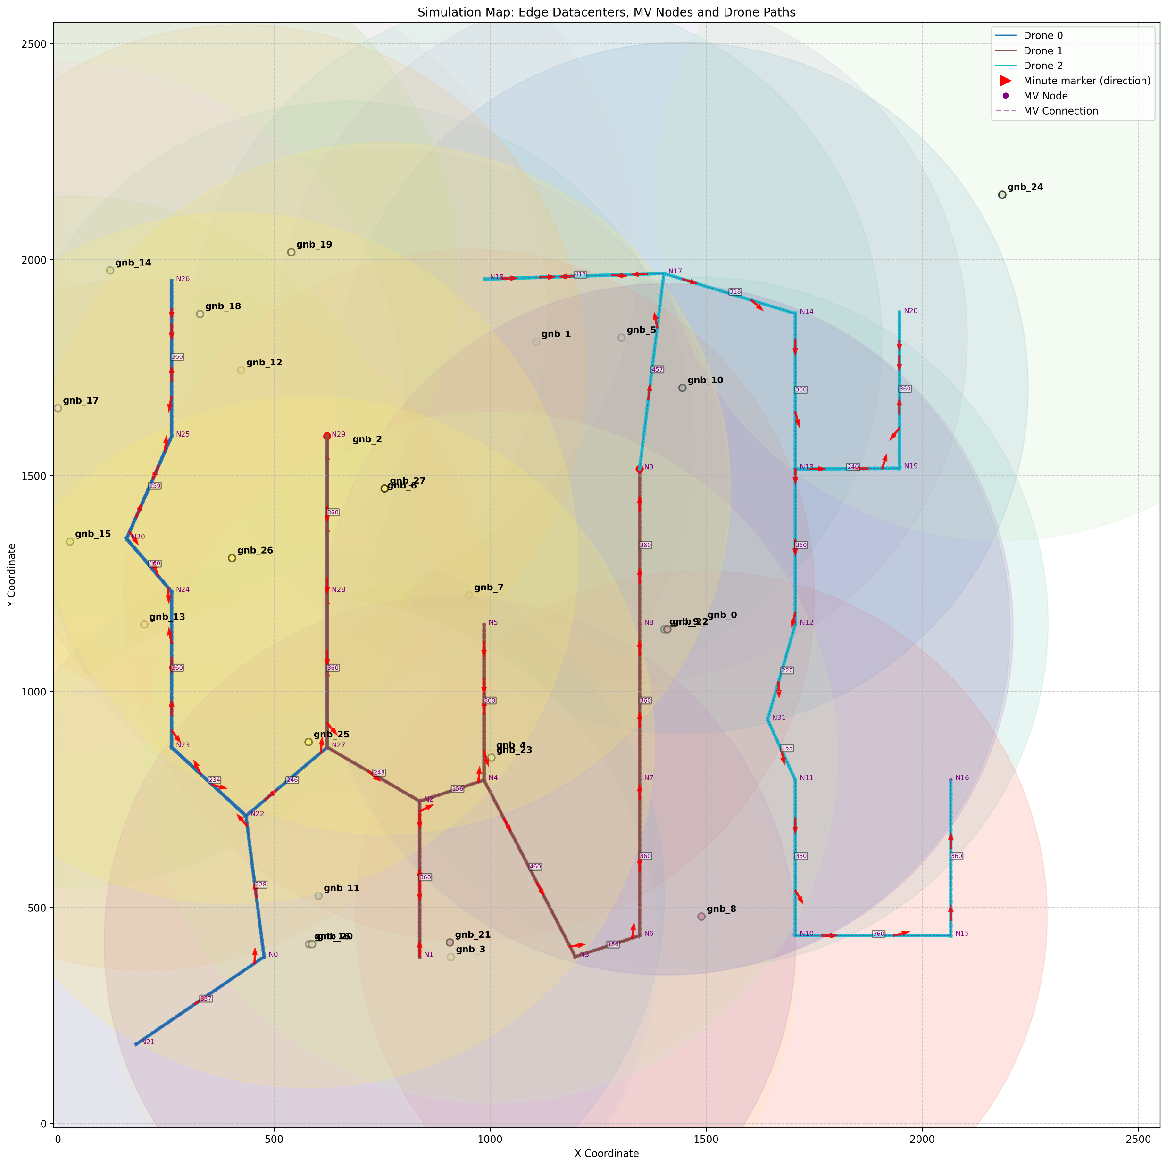

Multi Drone Scenario
Scenario : 2 Drones
Execution Time: ~40 minutes
Scenario : 4 Drones
Execution Time: ~28 minutes
Scenario : 4 Drones
Execution Time: ~20 minutes

Slide 18
Multi Drone Results

Slide 19
Multi Drone Results Edge Success Rate for different Maximum Acceptable Latency

